Slide 1

Media consumption habits in nepal
18th feb 2024

Slide 2
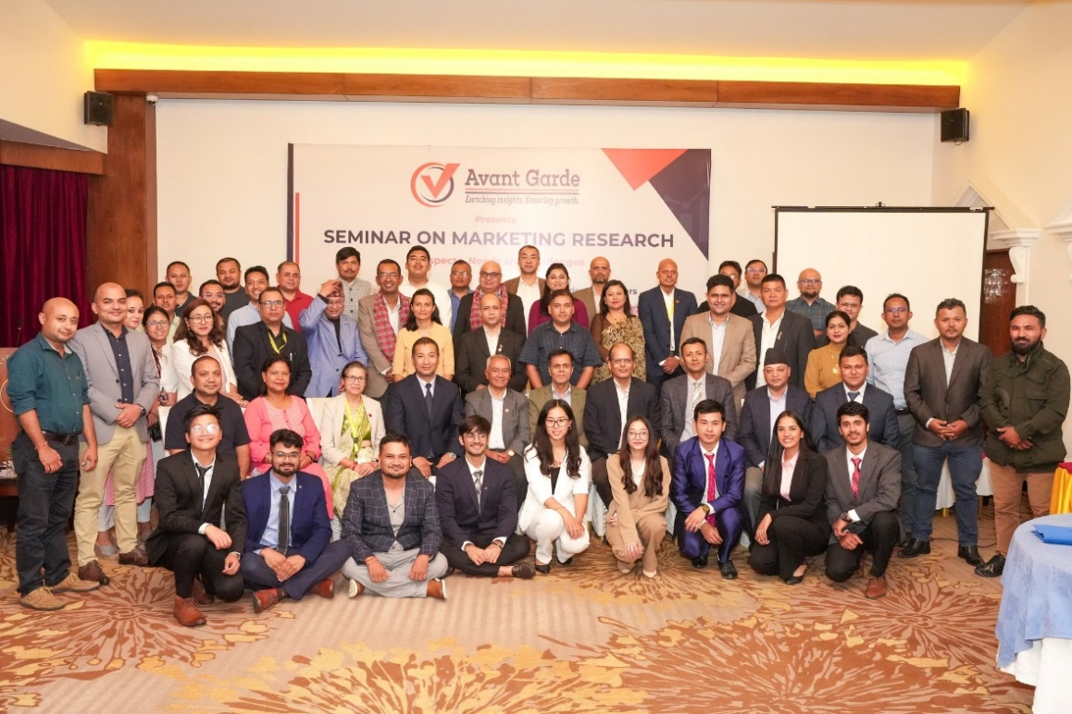
ABOUT US: AVANT GARDE SOLUTIONS PRIVATE LTD 1/10
ABOUT US: AVANT GARDE SOLUTIONS PRIVATE LTD 1/10
Industry experience: FMCG, Technology (Telecom, ISP), Automobiles, Consumer Electronics, Education, Health, Sanitation and Hygiene
We specialize in market research, social research,
project monitoring, and evaluation
A research and consulting firm
We have been in operation since 2010

Slide 3
























OUR CLIENTS 2/10
OUR CLIENTS 2/10

Slide 4









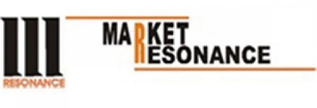














OUR CLIENTS 3/10
OUR CLIENTS 3/3

Slide 5




Research Purpose 4/10
Introduction
Media consumption is a powerful tool for personal enrichment and collective discourse, engaging individuals with content ranging from news to entertainment.
This consumption informs their understanding of the world, shaping cultural preferences and societal perspectives.

Slide 6

Research Objectives 5/10
Research Objectives
To comprehend media consumption habits and preferences across demographics in Nepal, providing insights for media organizations and policymakers to adapt to changing trends.
1

Slide 7




Methodology 7/10
METHODOLOGY
Research Design
Sample Size
Data Analysis
Quantitative data with the survey questionnaire
819 respondents from 32 districts in seven provinces of Nepal.
  Descriptive statistics using Excel and SPSS.
Data Collection Procedure
Methods
Computer Assisted Personal Interview (CAPI) with respondents.
Quantitative
Notes:
CAPI: Computer Assisted Personal Interview

Slide 8
FINDINGS

Slide 9


How trustworthy are the following media In Nepal?
How trustworthy are the following media In Nepal?
44% of respondents stated radio is trustworthy.

Slide 10

What Are your preferred media for news in Nepal?
What are your preferred media for news in Nepal?
73% of respondents prefer social media for news.

Slide 11
What Are your preferred media for news in the provinces of Nepal?
What Are your preferred media for news in the provinces of Nepal?
48% of respondents who are from Koshi province prefer television for news.

Slide 12

What are your preferred media for news in Nepal based on gender?
Which are the most frequent activities performed in smartphones?
74% of female respondents prefer social media for news.

Slide 13

What are your preferred media for news in Nepal based on employment level?
What are your preferred media for news in Nepal based on employment level?
100% of retired respondents prefer newspapers for news.

Slide 14
What are your preferred media for news in Nepal based on family income?
What are your preferred media for news in Nepal based on family income?
30% of respondents whose income level is less than 10,000 prefers word of mouth for news.

Slide 15


What are your preferred media for news in Nepal based on urbanicity?
Which are the most frequent activities performed in smartphones?
72% of rural respondents prefer social media for news.

Slide 16

What are your preferred media for news in Nepal based on educational level?
What are your preferred media for news in Nepal based on urbanicity?
96% of respondents with bachelor’s degrees prefer social media for news.

Slide 17


What are your preferred media for news in koshi province of Nepal?
What are your preferred media for news in koshi province of Nepal?
48% of respondents from Koshi province prefer television for news.

Slide 18

What are your preferred media for news in Madhesh province of Nepal?
What are your preferred media for news in Madhesh province of Nepal?
26% of respondents from Madhesh province prefer radio for news.

Slide 19

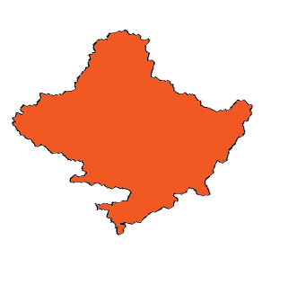
What are your preferred media for news in Bagmati province of Nepal?
What are your preferred media for news in Bagmati province of Nepal?
73% of respondents from Bagmati province prefer social media for news.

Slide 20


What are your preferred media for news in Gandaki Province of nepal?
What are your preferred media for news in Gandaki Province of Nepal?
58% of respondents from Gandaki province prefer word of mouth for news.

Slide 21

What are your preferred media for news in lumbini province of Nepal?
What are your preferred media for news in lumbini province of Nepal?
18% of respondents from Lumbini province prefer newspaper for news.

Slide 22
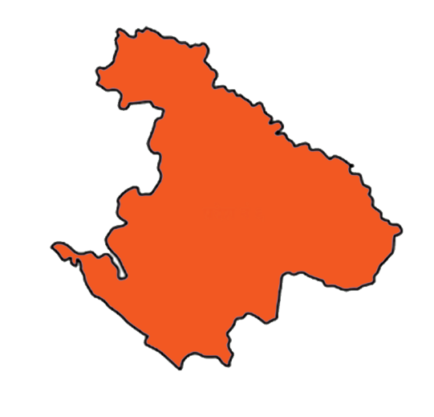
What are your preferred media for news in Karnali province of Nepal?
What are your preferred media for news in Karnali province of Nepal?
40% of respondents from Karnali province prefer radio for news.

Slide 23

What are your preferred media for news in Sudurpashchim province of Nepal?
What are your preferred media for news in Sudurpashchim province of Nepal?
40% of respondents from Sudurpashchim province prefer radio for news.

Slide 24
CONCLUSION
Despite social media being the most favored for news consumption, radio and television are considered the most reliable sources.
People with higher education, higher incomes, and urban residency prefer modern news sources, while those with less education, lower incomes, and rural residency tend to prefer traditional news sources.

Slide 25
THANK YOU
Avant Garde Solutions Pvt. Ltd
Sankhamul, Kathmandu, Nepal
info@avantgarde.com.np
www.avantgarde.com.np
+977 1 5242340 | 5912340

