Slide 1

PUBLIC perception study on smartphones
22nd jun 2019

Slide 2
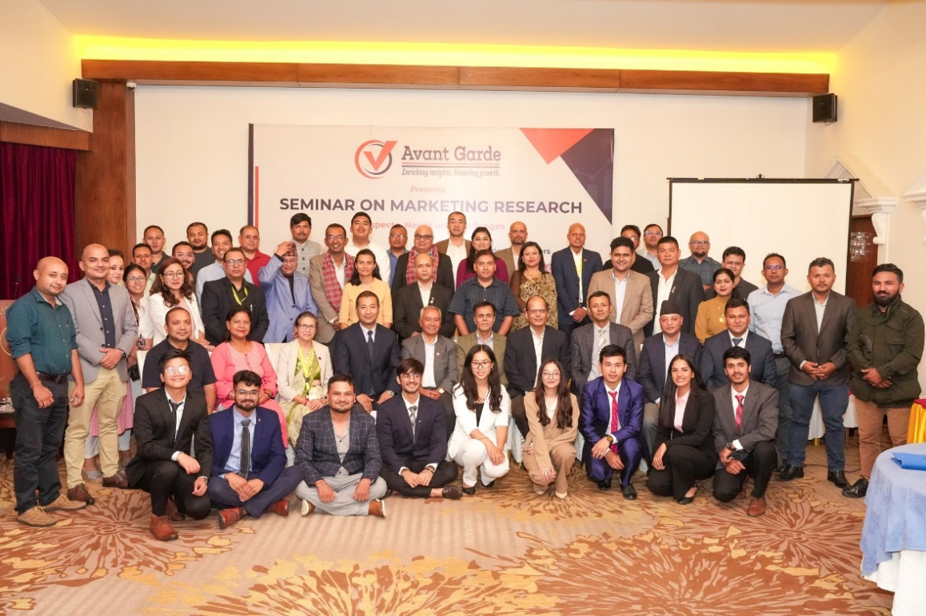
ABOUT US: AVANT GARDE SOLUTIONS PRIVATE LTD 1/10
ABOUT US: AVANT GARDE SOLUTIONS PRIVATE LTD 1/10
Industry experience: FMCG, Technology (Telecom, ISP), Automobiles, Consumer Electronics, Education, Health, Sanitation and Hygiene
We specialize in market research, social research,
project monitoring, and evaluation
A research and consulting firm
We have been in operation since 2010

Slide 3
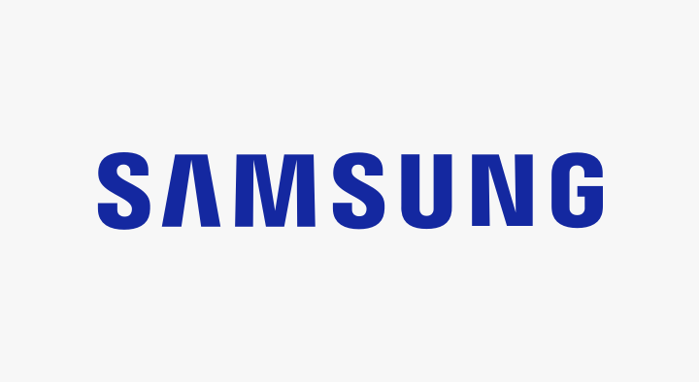























OUR CLIENTS 2/10
OUR CLIENTS 2/10

Slide 4
























OUR CLIENTS 3/10
OUR CLIENTS 3/3

Slide 5





Research Purpose 4/10
Introduction
Smartphones are essential in our daily lives, influencing everything from work to socializing by keeping us connected, informed, and organized.
Understanding public perception of smartphones helps reveal their societal and behavioral impact, shaping market trends and technology developments.
Studying these perceptions is crucial for designing better technology and making policies that enhance daily life, ensuring smartphone development aligns with user needs and preferences.

Slide 6

Research Objectives 5/10
Research Objectives
To analyze smartphone usage patterns, preferences, and purchase influencers among users in Nepal, providing insights for manufacturers and retailers to better cater to market needs.
1

Slide 7




Methodology 7/10
METHODOLOGY
Research Design
Sample Size
Data Analysis
Quantitative data with the survey questionnaire
542 respondents from inside Kathmandu valley.
  Descriptive statistics using Excel and SPSS.
Data Collection Procedure
Methods
Computer Assisted Personal Interview (CAPI) with respondents.
Quantitative
Notes:
CAPI: Computer Assisted Personal Interview

Slide 8
FINDINGS

Slide 9

Methodology:
Training and quality control 10/10
Which are the most frequent activities performed in smartphones?

Slide 10

Methodology:
Training and quality control 10/10
How Frequently do you change your smartphone?
60.40% of respondents stated that they changed their smartphone when the existing one is out of order.

Slide 11

When are you planning to upgrade to a new smartphone?
When are you planning to upgrade to a new smartphone?
34.20% of respondents stated that they plan to upgrade to a new smartphone when their existing one is out of order.

Slide 12
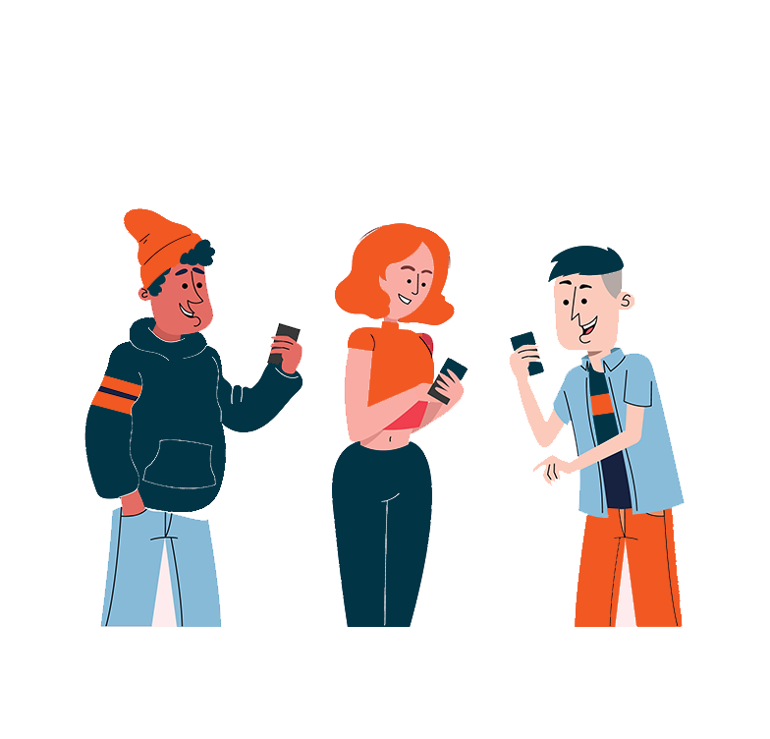
Where do consumers get information for purchase of smartphones?
Where do consumers get information for purchase of smartphones?
57.55% of respondents stated that they got information for purchasing smartphones from friends, family, or relatives.

Slide 13
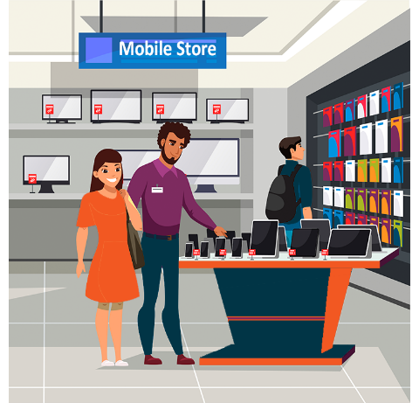
Where do consumers purchase smart phones from?
Where do consumers purchase smart phones from?

Slide 14

Which feature do you prioritize the most while purchasing a smartphone?
Which feature do you prioritize the most while purchasing a smartphone?
32.90% of the respondent stated that they prioritized rear camera the most while purchasing a smartphone.

Slide 15

Who influenced you to purchase your current smartphone?
Who influenced you to purchase your current smartphone?
57.35% of the respondents stated that they made their own purchase decision for their current smartphone.

Slide 16

CONCLUSION & RECOMMENDATIONS
Smartphones are mainly used for communication, social media, and photography, with the rear camera being the top priority for users
Users typically replace smartphones when they become non-functional, with many planning to upgrade within the next six months.
Purchasing decisions are heavily influenced by personal choice and recommendations from friends and family.

Slide 17
THANK YOU
Avant Garde Solutions Pvt. Ltd
Sankhamul, Kathmandu, Nepal
info@avantgarde.com.np
www.avantgarde.com.np
+977 1 5242340 | 5912340

