Slide 1

Market promotion of electric vehicles
7th oct 2018

Slide 2
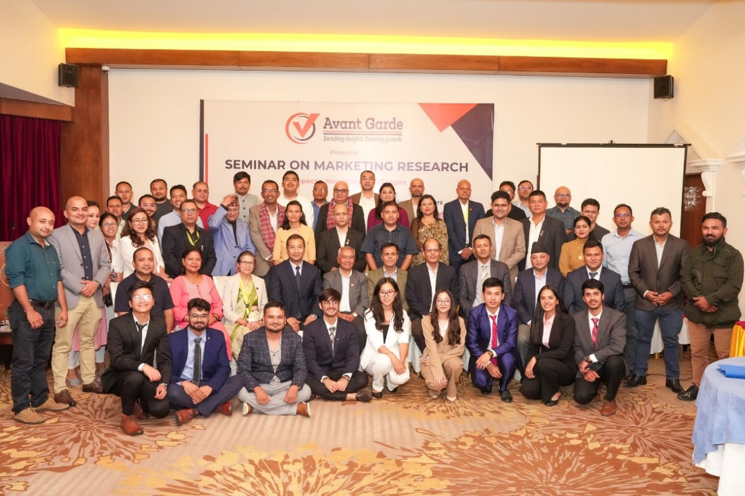
ABOUT US: AVANT GARDE SOLUTIONS PRIVATE LTD 1/10
ABOUT US: AVANT GARDE SOLUTIONS PRIVATE LTD 1/10
Industry experience: FMCG, Technology (Telecom, ISP), Automobiles, Consumer Electronics, Education, Health, Sanitation and Hygiene
We specialize in market research, social research,
project monitoring, and evaluation
A research and consulting firm
We have been in operation since 2010

Slide 3
























OUR CLIENTS 2/10
OUR CLIENTS 2/10

Slide 4
























OUR CLIENTS 3/10
OUR CLIENTS 3/3

Slide 5






Research Purpose 4/10
Introduction
Electric-Powered Motors: EVs run on electricity, using electric motors and rechargeable batteries instead of conventional internal combustion engines and fossil fuels.
Historical Context: The concept of electric vehicles dates back to the early 19th century, showing a long history of development and innovation.
Market Penetration: Despite their long history, few people own EVs today, resulting in limited market achievements.

Slide 6
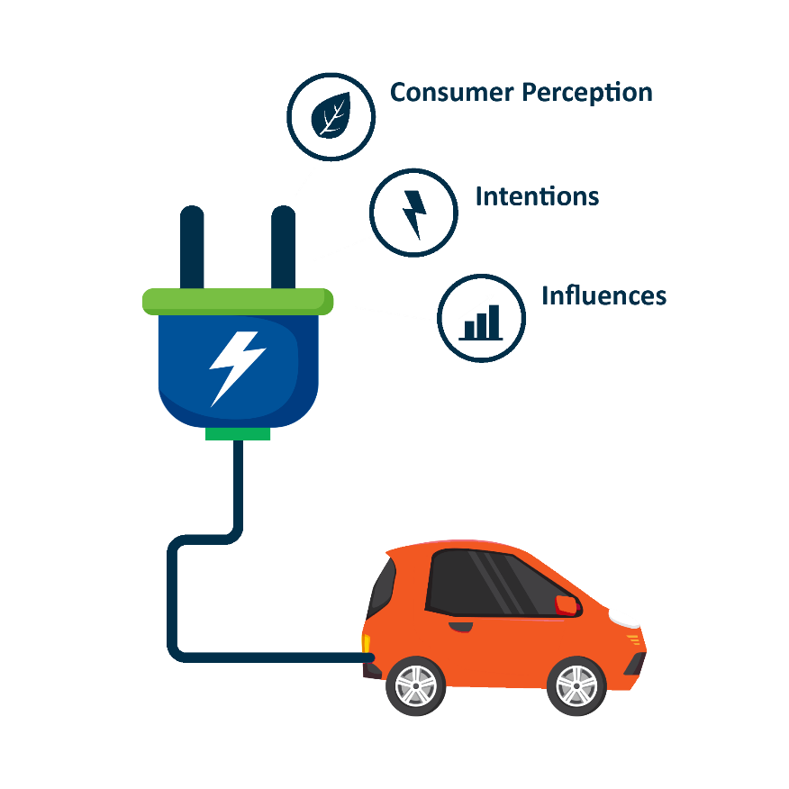
Research Objectives 5/10
Research Objectives
To analyze and understand the factors influencing consumer perceptions, attitudes, and intentions towards adopting electric vehicles (EVs) in Nepal
1

Slide 7




Methodology 7/10
Methodology
Research Design
Sample Size
411 samples (KTM, Bhaktapur, Lalitpur, Banke, Rupandehi)
Quantitative
Survey Questionnaire with Non EV users
Qualitative Methods
Focus Group Discussion (Non EV Users)
In depth Interview (EV Users)
Key Informants Interview (DOTM , Dealers)
Sampling Approach & Distribution
Purposive Sampling
Data Analysis
  Descriptive statistics using Excel and SPSS.
Notes:
CAPI: Computer Assisted Personal Interview

Slide 8
FINDINGS

Slide 9

Methodology:
Training and quality control 10/10
Demographic : Gender & Age Group
79.6% are below 45 years.

Slide 10

Methodology:
Training and quality control 10/10
Demographic :Education
43.80% of the respondents have Bachelor degree.

Slide 11

Methodology:
Training and quality control 10/10
Demographic : Occupation
41.40 % of the respondents work in private service.

Slide 12


Methodology:
Training and quality control 10/10
Duration of Vehicle Use
27.70% of the respondents use vehicle for 3-5 years.

Slide 13




Methodology:
Training and quality control 10/10
Purpose of Vehicle Use
80.50% of the respondents use vehicle for going office.

Slide 14


Methodology:
Training and quality control 10/10
If Second Vehicle, How many?
65.82% of the respondents have one second vehicle.

Slide 15
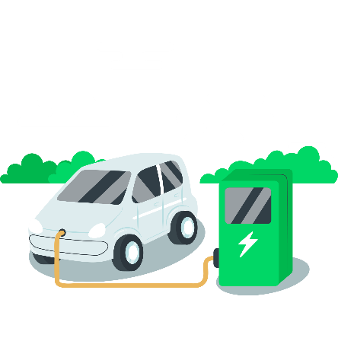
Methodology:
Training and quality control 10/10
If want to buy EV, what are the reasons?
89.10% of the respondents want to buy Ev to reduce pollutions.
54% of the respondents want to buy electric vehicle in future.

Slide 16
Methodology:
Training and quality control 10/10
Why don’t want to buy EV?
78.16% of the respondents don’t want to buy EV due to no available of charging stations.

Slide 17
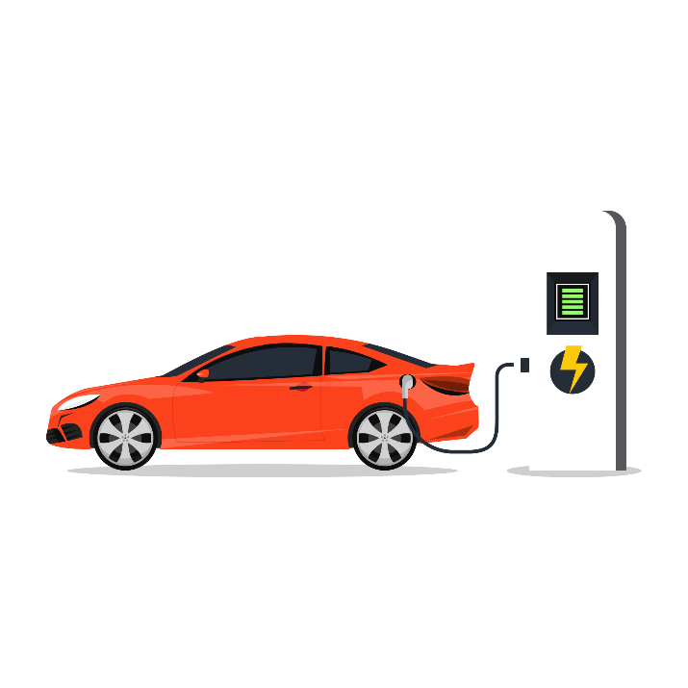
Methodology:
Training and quality control 10/10
What may encourage to buy?
80.06% of the respondents may buy EV if there will be available of fast charging stations.

Slide 18
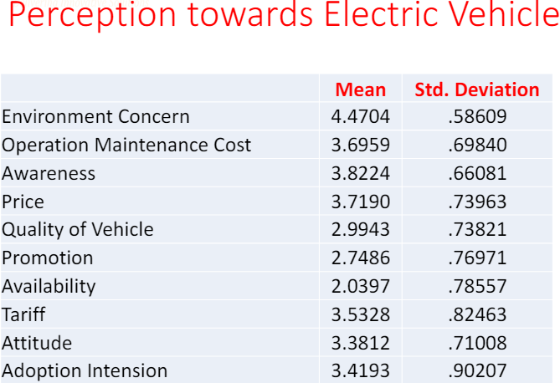
Methodology:
Training and quality control 10/10
Perception Toward Electric Vehicle

Slide 19
Methodology:
Training and quality control 10/10
Regression Results
Quality of EV, Low tariff, Awareness, Low operation and maintenance cost and availability creates attitude towards EV. (βQ= .274 ,βT=.201 ,βA=.181, βO=.147, βAV=.1O1, R 2 =.359)
Price, Promotion and Environmental Concern have no affect on attitude formation towards EV.
Adoption Intension towards EV is formed through attitude (β=.844, R 2 = .441)

Slide 20
FOCUS GROUP DISCUSSION (FGD)
For Non-EV Users

Slide 21
RESULTS
High price although low custom tax & low road tax
Prefer as a second car within city, use as a fancy vehicle
Unaware of EV features, distance travelled at full charge, safety issues, price of spare parts
Lack of expertise for maintenance
Unaware of EV features, distance travelled at full charge, safety issues, price of spare parts
Issues: Fast charging stations, vehicle pickup, battery life, high battery replacement cost, constant voltage supply, no resale value, Lithium Ion battery disposal

Slide 22
IN-DEPTH INTERVIEW
For EV Users

Slide 23
RESULTS
High price compared to gasoline vehicle.
Use as a city car, have not taken outside KTM.
Easy and comfort while driving.
Low operation and maintenance cost
Easy charging at home and office
Not reliable for long route

Slide 24
IN-DEPTH INTERVIEW
(Government Stakeholders)

Slide 25
RESULTS
Government promoting EV, Plan: 20% of the vehicle sales are EV by 2020 A. D.
Low custom duty and road tax
Won’t establish charging station, encourage dealer
Working for setting charging standards
No current battery disposal plan and modality

Slide 26
KEY INFORMANTS INTERVIEW
(Dealers)

Slide 27
RESULTS
Pre Introduction and experimental Phase, EV market is growing
No aggressive promotion
Low operation and maintenance cost
Limited sales, no infrastructure to sell in high volume
Immediate switching to EV is low
Pick up is an issue

Slide 28
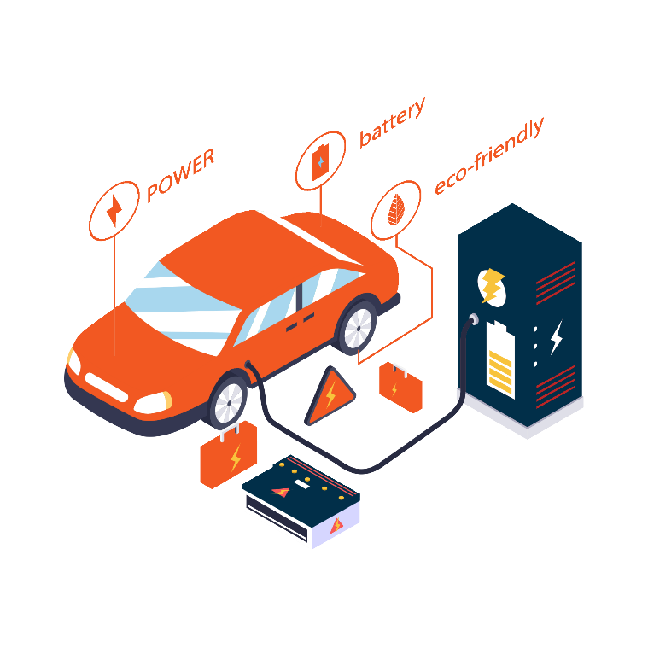
CONCLUSION & RECOMMENDATIONS
Focus on charging station
Highlight product features in promotion
Manage battery disposal mechanism

Slide 29
THANK YOU
Avant Garde Solutions Pvt. Ltd
Sankhamul, Kathmandu, Nepal
info@avantgarde.com.np
www.avantgarde.com.np
+977 1 5242340 | 5912340

