Slide 1

Market promotion of 4G LTE
17th oct 2018

Slide 2
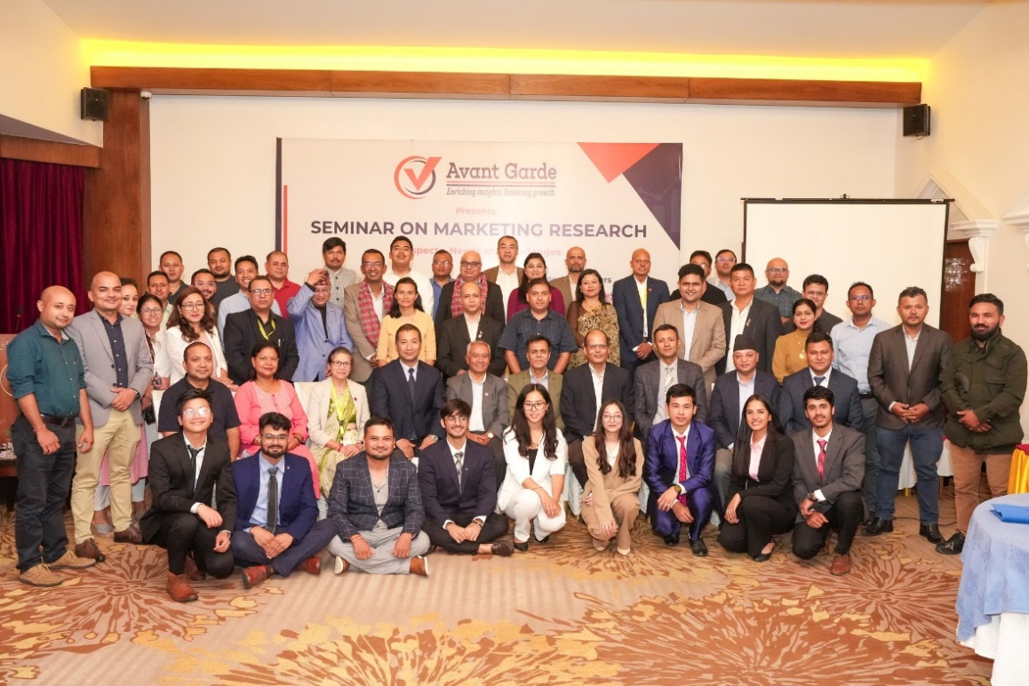
ABOUT US: AVANT GARDE SOLUTIONS PRIVATE LTD 1/10
ABOUT US: AVANT GARDE SOLUTIONS PRIVATE LTD 1/10
Industry experience: FMCG, Technology (Telecom, ISP), Automobiles, Consumer Electronics, Education, Health, Sanitation and Hygiene
We specialize in market research, social research,
project monitoring, and evaluation
A research and consulting firm
We have been in operation since 2010

Slide 3
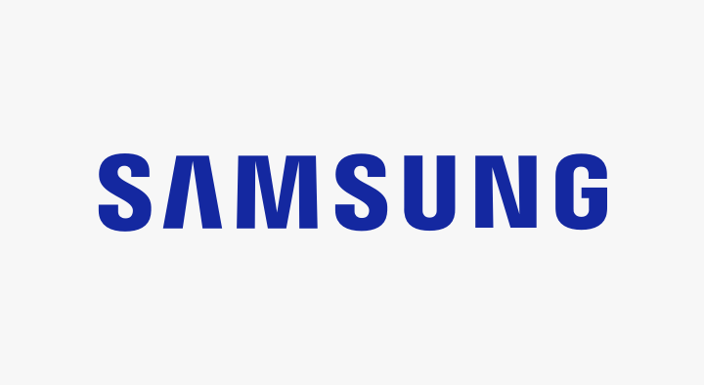























OUR CLIENTS 2/10
OUR CLIENTS 2/10

Slide 4
























OUR CLIENTS 3/10
OUR CLIENTS 3/10

Slide 5
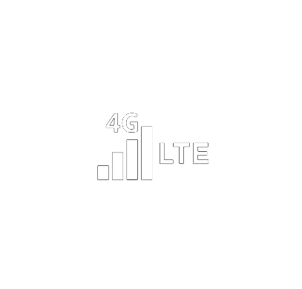





Research Purpose 4/10
Introduction 4/10
4G LTE, or Fourth Generation Long Term Evolution, is a wireless data transmission standard that offers speeds up to ten times faster than 3G.
Despite the presence of 4G LTE in Nepal, it has not achieved significant market success.
Promoting 4G LTE technology is crucial for improving connectivity and internet access throughout Nepal.

Slide 6
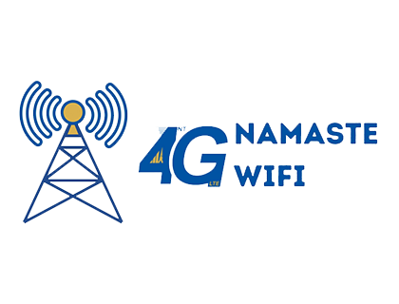

Research Objectives 5/10
Research Objectives 5/10
To evaluate the market adoption of 4G LTE technology in Nepal and identify factors influencing its limited success
1

Slide 7





Methodology 7/10
Methodology 7/10
Research Design
Sample Size
942 Samples (KTM, Bhaktapur, Lalitpur, Saptari, Morang, Sunsari)
Quantitative
Survey Questionnaire with Non EV users
Qualitative Methods
• Focus Group Discussion (Non EV Users)
In depth Interview (EV Users)
Key Informants Interview (DOTM , Dealers)
Sampling Approach & Distribution
Purposive Sampling
Data Analysis
  Descriptive statistics using Excel and SPSS.
Notes:
CAPI: Computer Assisted Personal Interview

Slide 8
FINDINGS
Overall

Slide 9

Methodology:
Training and quality control 10/10
Demographic : Gender & Age Group 9/10
74.4% are below 35 years.

Slide 10

Methodology:
Training and quality control 10/10
Demographic :Education 10/10
53.05% of the respondents have Master or higher degree.

Slide 11

Methodology:
Training and quality control 10/10
Demographic : Occupation 11/10
44 % of the respondents work in private service.

Slide 12
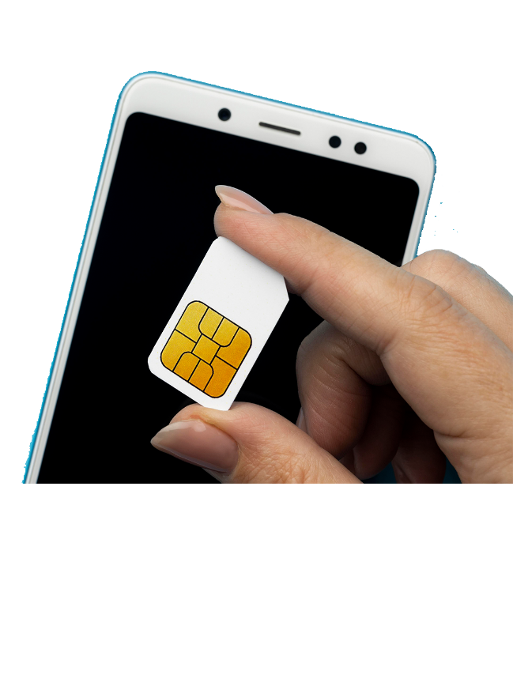
Methodology:
Training and quality control 10/10
Source of Data in Smartphone 12/10
71.66% of the respondents use SIM card.

Slide 13

Methodology:
Training and quality control 10/10
SIM Used for Mobile Data 13/10
81.33% of the respondents use NCELL sim for mobile date.

Slide 14
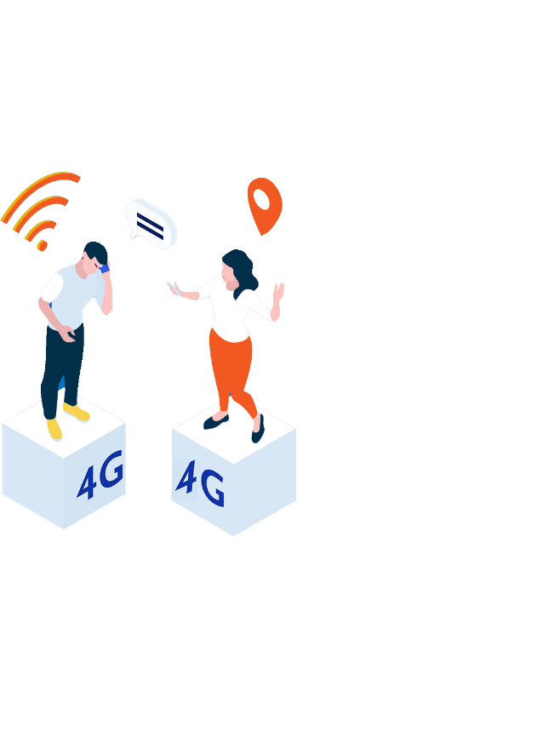
Methodology:
Training and quality control 10/10
Frequency of Data Use from SIM Card 14/10
50.07% of the respondents used sim card for data more than seven times a day.

Slide 15

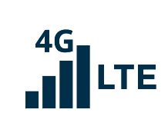
Methodology:
Training and quality control 10/10
Location of Data Use 15/10
66.07% of the respondents use data while travelling.

Slide 16
Methodology:
Training and quality control 10/10
Time of Data Use 16/10
79.11% of the respondents use mobile date in evening.

Slide 17
Methodology:
Training and quality control 10/10
Money Spend in Mobile Data 17/10
29.04% of the respondents spend Rs401-800 in mobile data.

Slide 18

Methodology:
Training and quality control 10/10
Purpose of Mobile Data 18/10
86.96% of the respondents spend use mobile data for social media.

Slide 19
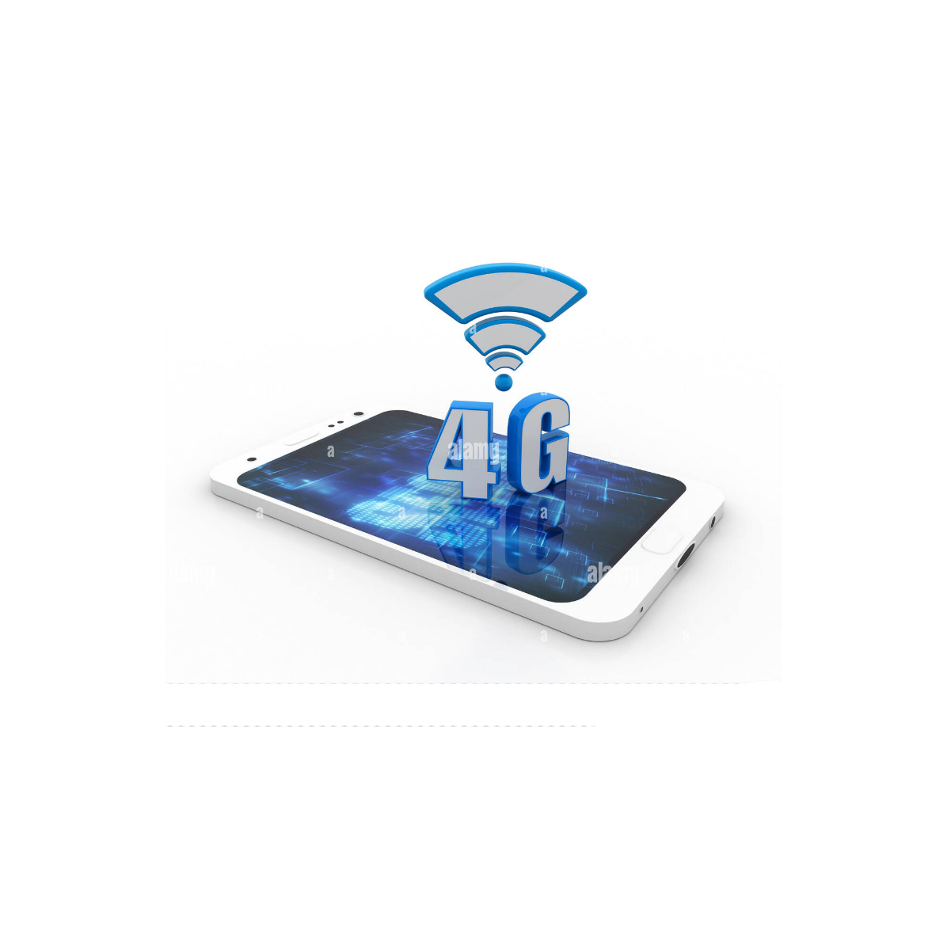
Methodology:
Training and quality control 10/10
Smartphone Support 4G LTE 19/10
82.81% of the respondents’ mobile support 4G LTE.

Slide 20
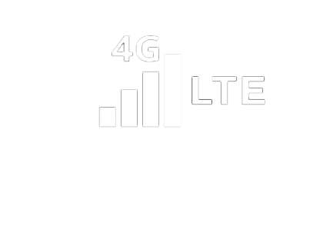
Methodology:
Training and quality control 10/10
Mobile Technology Use 20/10
82.07% of the respondents’ use 4G LTE.

Slide 21
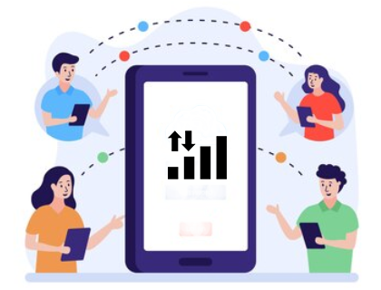
Methodology:
Training and quality control 10/10
Use Mobile Data Package 20/10
75.11% of the respondents’ use mobile data package.

Slide 22
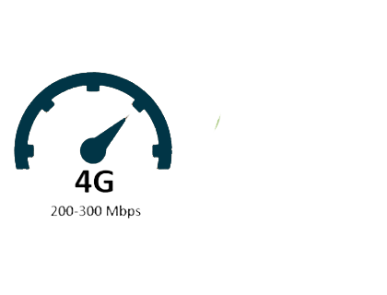
Methodology:
Training and quality control 10/10
What Encourage You To Use 4G LTE? 20/10
73.96% of the respondents encourage to use 4G LTE due to fast speed/ performance.

Slide 23
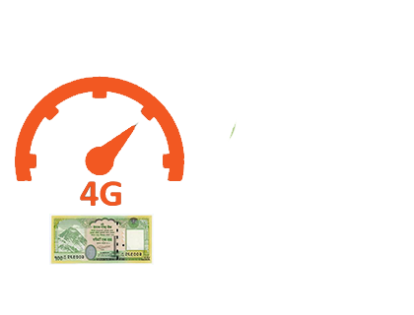
Methodology:
Training and quality control 10/10
Why Don’t You Use Mobile Data ? 20/10
74.44% of the respondents don’t use mobile date due to high cost.

Slide 24
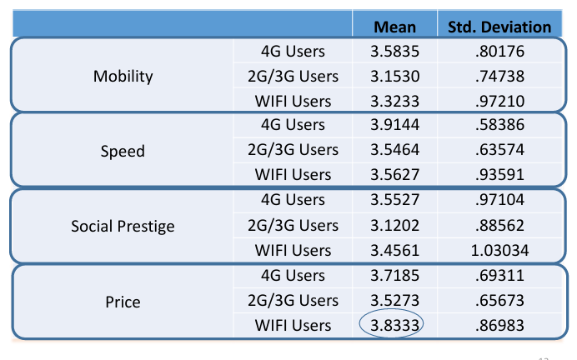
Methodology:
Training and quality control 10/10
Perception Towards 4G LTE 20/10

Slide 25
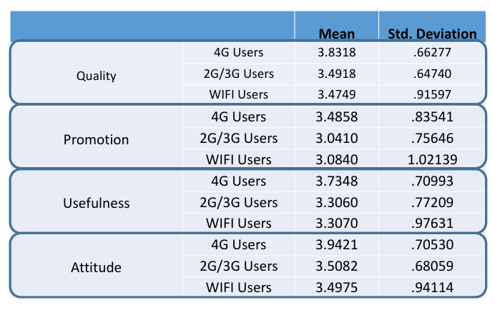
Methodology:
Training and quality control 10/10
Perception Towards 4G LTE 20/10

Slide 26
Methodology:
Training and quality control 10/10
Regression Results 19/10
Promotion, Speed and Quality creates perceived usefulness (βP= .517 ,βS=.218 ,βQ=.156, R2 =.618)
Social prestige, price and mobility have no affect on perceived usefulness
Attitude towards 4G is formed through perceived usefulness (β=.749, R2 =.592)

Slide 27
FOCUS GROUP DISCUSSION (FGD)
For 4G Users

Slide 28
RESULTS
Tariff is high
Packages are cost effective and preferable however difficult to understand sometimes.
Use mobile data during travelling for maps, email, social media
Useful and saves time.
Faster than 3G.
No affect on social status & large number of dark spots.

Slide 29
FOCUS GROUP DISCUSSION (FGD)
For Non- 4G Users

Slide 30
RESULTS
WIFI available at home.
4G is expensive. Option to use if price is lowered.
Use WIFI data for social media, watching movies, serials.
People say 4G is expensive.

Slide 31
KEY INFORMANTS INTERVIEW
(Regulator)

Slide 32
RESULTS
No significant difference between 3G and 4G in terms of speed.
Large number of blind spots.
Bandwidth limitation – 5MHz (NT and NCELL), 10 MHz (SMART).
Low marketing role.
No motivation for Users: Limited coverage and speed.
4G data will grow with progression of socio economic conditions.

Slide 33
KEY INFORMANTS INTERVIEW
(Operators)

Slide 34
RESULTS
Consumer perceive 4G as high speed.
No significant difference between 3G and 4G.
Expansion at low pace. Limited investment.
No aggressive marketing. Limited features for marketing.
No revenue target on 4G & 4G packages are effective.
Limited 4G handsets penetration & 4G data will grow with content and service based solutions

Slide 35

CONCLUSION & RECOMMENDATIONS
Availability of 4G handsets in market. Consumers ready to use 4G
Allocate 4G Spectrum (Regulator).
Expand 4G network (Operators)
Initiate promotion indicating speed and quality.
Develop content and service based solutions 2.

Slide 36
THANK YOU
Avant Garde Solutions Pvt. Ltd
Sankhamul, Kathmandu, Nepal
info@avantgarde.com.np
www.avantgarde.com.np
+977 1 5242340 | 5912340

