Slide 1

Nepali consumers during the
covid-19 lockdown
22nd jun 2020

Slide 2
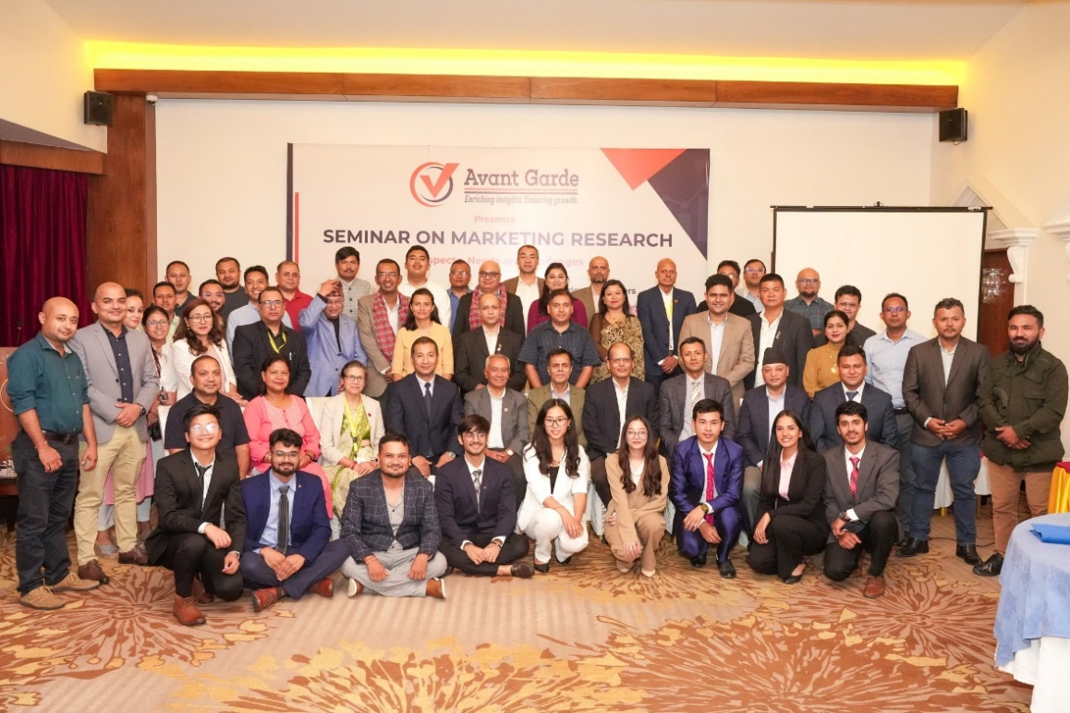
ABOUT US: AVANT GARDE SOLUTIONS PRIVATE LTD 1/10
ABOUT US: AVANT GARDE SOLUTIONS PRIVATE LTD 1/3
Industry experience: FMCG, Technology (Telecom, ISP), Automobiles, Consumer Electronics, Education, Health, Sanitation and Hygiene
We specialize in market research, social research,
project monitoring, and evaluation
A research and consulting firm
We have been in operation since 2010

Slide 3
























OUR CLIENTS 2/10
OUR CLIENTS 2/3

Slide 4
























OUR CLIENTS 3/10
OUR CLIENTS 3/3

Slide 5






Research Purpose 4/10
INTRODUCTION
A lockdown is a restriction imposed by authorities to confine people to their homes or limit movement within a specific area, often implemented during emergencies like pandemics or security threats.
People adjusted their spending habits to cope with uncertain financial situations, emphasizing essential purchases and cutting back on non-essentials.
Individuals had to categorize goods and services as essential or non-essential, directing their spending to meet immediate needs.

Slide 6
Research Objectives 5/10
RESEARCH OBJECTIVES
To examined how the COVID-19 lockdown impacted daily life, finances, and shopping habits of Kathmandu Valley's consumers, with a focus on income changes, spending shifts, and online shopping adoption.
1

Slide 7




Methodology 7/10
METHODOLOGY
Research Design
Sample Size
Data Analysis
Quantitative data with the survey questionnaire
150 respondents from inside Kathmandu valley.
  Descriptive statistics using Excel and SPSS.
Methods
Quantitative
Notes:
CAPI: Computer Assisted Personal Interview

Slide 8
FINDINGS

Slide 9

Methodology:
Training and quality control 10/10
Nepali Consumers’ Activities During The Lockdown
98% of the respondents spend time by browsing social media.

Slide 10
Methodology:
Training and quality control 10/10
Nepali Consumers’ Concern About The Covid-19 Situation
88% of the respondents are concern about overall public health.

Slide 11

Methodology:
Training and quality control 10/10
Nepali Consumers’ Income-Expense Trend During The Lockdown
95% of the respondents says they need to be very careful on their spending.

Slide 12

Methodology:
Training and quality control 10/10
Category of Goods Purchased by Nepali Consumers During the Lockdown
79% of the respondents purchase groceries.

Slide 13

Methodology:
Training and quality control 10/10
Items Purchased Online by Nepali Consumers During the Lockdown
54% of the respondents have not purchased anything online.

Slide 14

CONCLUSION
The lockdown prompted significant lifestyle changes, with increased time spent on home-based activities like social media and cleaning.
Job losses and delayed salaries led to heightened financial caution among consumers, resulting in cuts to non-essential expenditures.
Despite initial uncertainty, there was a notable adoption of online shopping for essential items, reflecting a growing reliance on digital platforms due to the pandemic.

Slide 15
THANK YOU
Avant Garde Solutions Pvt. Ltd
Sankhamul, Kathmandu, Nepal
info@avantgarde.com.np
www.avantgarde.com.np
+977 1 5242340 | 5912340

