Slide 1

PUBLIC perception on the clean feed policy in Nepal
23rd oct 2020

Slide 2
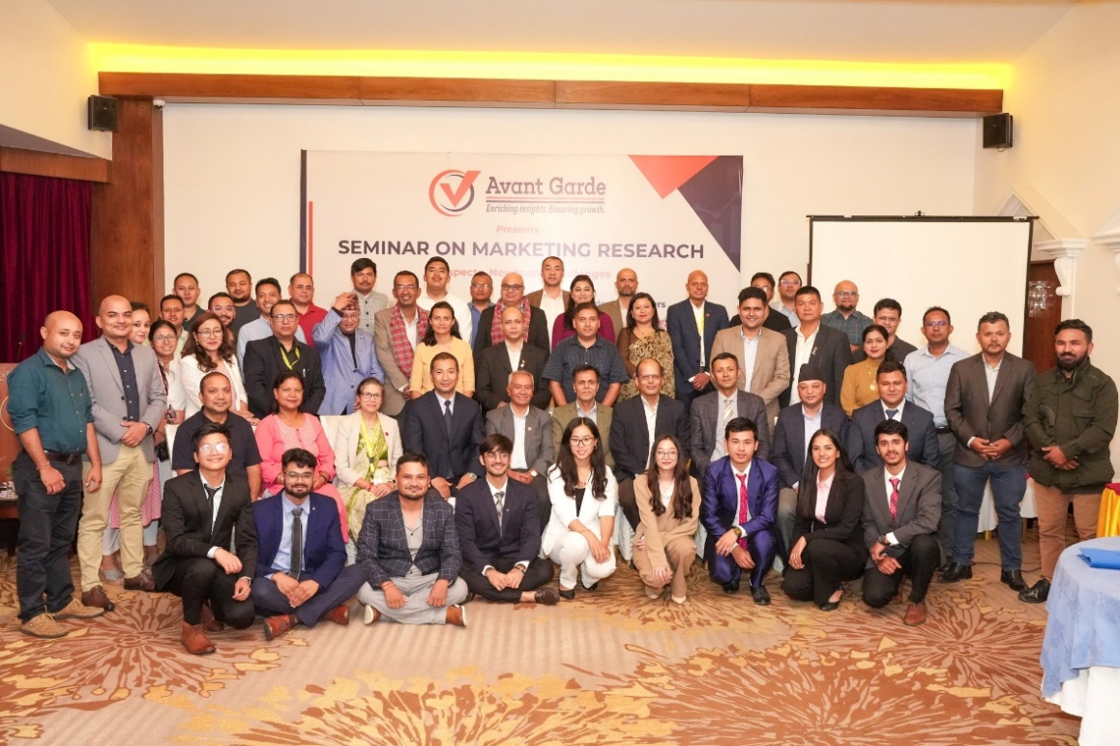
ABOUT US: AVANT GARDE SOLUTIONS PRIVATE LTD 1/10
ABOUT US: AVANT GARDE SOLUTIONS PRIVATE LTD 1/3
Industry experience: FMCG, Technology (Telecom, ISP), Automobiles, Consumer Electronics, Education, Health, Sanitation and Hygiene
We specialize in market research, social research,
project monitoring, and evaluation
A research and consulting firm
We have been in operation since 2010

Slide 3
























OUR CLIENTS 2/10
OUR CLIENTS 2/3

Slide 4
























OUR CLIENTS 3/10
OUR CLIENTS 3/3

Slide 5





Research Purpose 4/10
INTRODUCTION
Nepal's clean feed policy, implemented on October 23, 2020, restricts foreign ads on foreign channels to promote the domestic advertising industry.
It is too early to evaluate the policy's impact on the growth of Nepal's advertising industry.
The policy expects a decline in foreign TV ads in Nepal, aiming to boost the domestic advertising sector.

Slide 6

Research Objectives 5/10
RESEARCH OBJECTIVES
To understand how Nepalese people perceive the clean feed policy, including their opinions and its potential impact.
1

Slide 7




Methodology 7/10
METHODOLOGY
Research Design
Sample Size
Data Analysis
Quantitative data with the survey questionnaire
210 respondents from inside Kathmandu valley.
  Descriptive statistics using Excel and SPSS.
Data Collection Procedure
Methods
Computer Assisted Personal Interview (CAPI) with respondents.
Quantitative
Notes:
CAPI: Computer Assisted Personal Interview

Slide 8
FINDINGS

Slide 9

Methodology:
Training and quality control 10/10
PERCEPTION ON CLEAN FEED POLICY
53% of the respondents states that clean feed policy will help to promote the local Nepali content & concept.

Slide 10

Methodology:
Training and quality control 10/10
PERCEPTION ON CLEAN FEED POLICY
46% of the respondents states that clean feed policy will boost the Nepali advertising industry.

Slide 11

CONCLUSION & RECOMMENDATIONS
The study indicates widespread support for the clean feed policy among respondents, showing general agreement in favor of its implementation.
Some individuals expressed dissatisfaction over potential additional cable service charges, highlighting a need to address the policy's financial implications.
Most respondents have positive views on the clean feed policy's potential benefits for Nepal’s advertisement industry, showing confidence in its contribution to the sector's growth.
Although it's too early to fully assess the clean feed policy's impact on the advertising industry, these initial perceptions provide valuable insights into public sentiment and expectations.

Slide 12
THANK YOU
Avant Garde Solutions Pvt. Ltd
Sankhamul, Kathmandu, Nepal
info@avantgarde.com.np
www.avantgarde.com.np
+977 1 5242340 | 5912340

