Slide 1

PERCEPTION OF GEN Z
ON
INFLUENCER MARKETING
JAN, 2025

Slide 2
OBJECTIVES AND METHODOLOGY
Research Objectives
To analyze consumer engagement, trust, and purchasing behavior influenced by influencers across various product categories and platforms.
Research Methodology
Length of Interview (LOI)
20 mins approx.
Location
Kathmandu Valley
Sample Size: 630
Male: 315
Female: 315
Age Group
18 - 25
Data Analysis
Descriptive statistics using Excel
Thematic analysis of open-ended data
Research Design
Quantitative data with the survey questionnaire
Data collection using digital data collection platform
Administered survey with experienced field enumerators
Computer Aided Personal Interview (CAPI) with the respondents

Slide 3
SHARE OF MIND

Slide 4
Research Purpose 4/10
TOM SPON AIDED (OVERALL)
Fashion and Clothing leads in spontaneous and aided recall, suggesting they have strong awareness on the category.
94 specifically mention Food and Beverages as the initial category that comes to mind when considering influencer marketing, while 213 recall it, and a total of 207 recognize.

Slide 5
Research Purpose 4/10
TOM SPON AIDED (MALE AND FEMALE)
Fashion and Clothing leads in spontaneous and aided recall among female, while food and beverage leads in spontaneous and aided recall among male.
Sample Size
315
315

Slide 6
RECALLED INFLUENCER

Slide 7
Research Purpose 4/10
RECALLED INFLUENCER (OVERALL) (1)
Celebrities are the most preferred influencer for beauty and skincare category.
Celebrities are the most preferred influencer for fashion and clothing category.
Food Blogger are the most preferred influencer for food and beverages category.
Celebrities are the most preferred influencer for tech and gadgets category.

Slide 8
Research Purpose 4/10
RECALLED INFLUENCER (OVERALL) (2)
Sportsperson are the most preferred influencer for health and fitness category.
Travel Vlogger are the most preferred influencer for travel and tourism category.
Celebrities are the most preferred influencer for entertainment and digital services category.

Slide 9
Research Purpose 4/10
RECALLED INFLUENCER (OVERALL) (3)
Celebrities are the most preferred influencer for educational and learning services category.
Travel Blogger are the most preferred influencer for automobile category.

Slide 10
Research Purpose 4/10
RECALLED INFLUENCER (FEMALE) (1)

Slide 11
Research Purpose 4/10
RECALLED INFLUENCER (FEMALE) (2)

Slide 12
Research Purpose 4/10
RECALLED INFLUENCER (MALE) (1)

Slide 13
Research Purpose 4/10
RECALLED INFLUENCER (MALE) (2)

Slide 14
FUNNEL OF DIFFERENT CATEGORIES

Slide 15
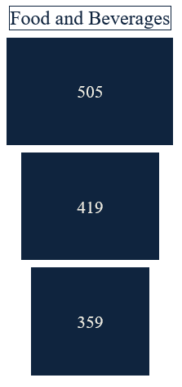
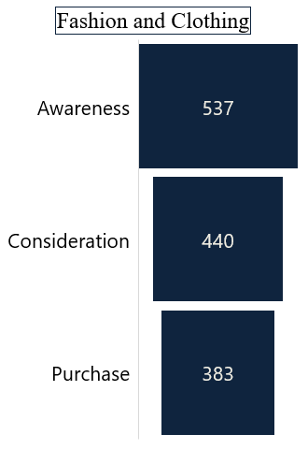
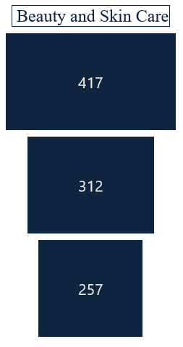
Research Purpose 4/10
FUNNEL (OVERALL) (1)
82%
83%
75%
87%
82%
86%

Slide 16
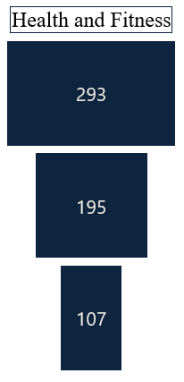
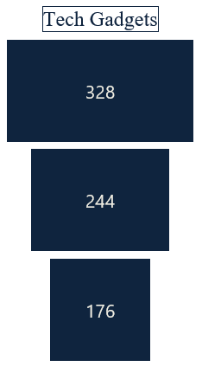
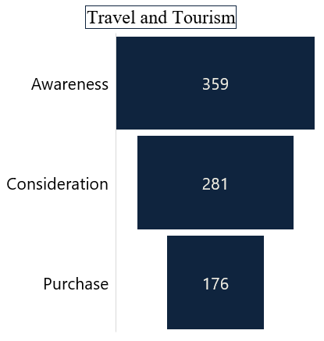
FUNNEL (OVERALL) (2)
78%
74%
67%
72%
55%
63%

Slide 17
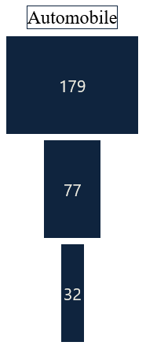
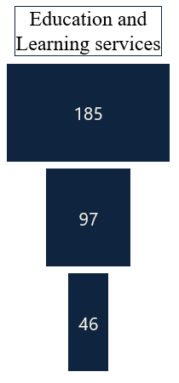
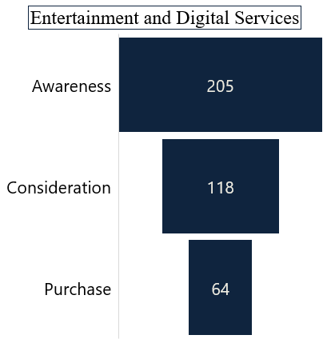
Research Purpose 4/10
FUNNEL (OVERALL) (3)
58%
43%
52%
54%
42%
47%

Slide 18
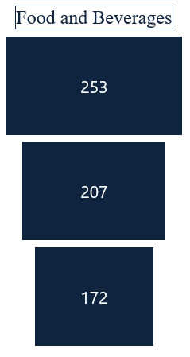
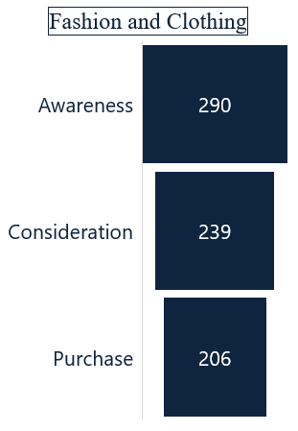
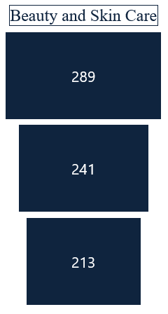
Research Purpose 4/10
FUNNEL (FEMALE) (1)
82%
83%
82%
86%
88%
83%

Slide 19
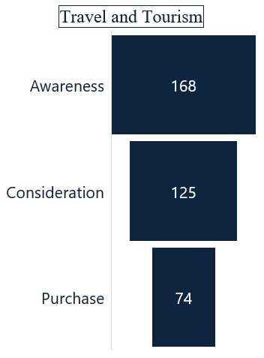
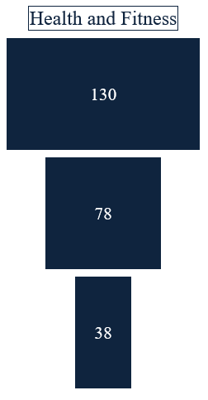
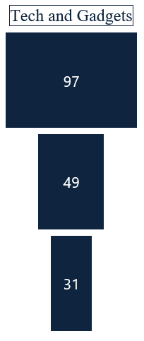
FUNNEL (FEMALE) (2)
74%
60%
51%
59%
63%
49%

Slide 20
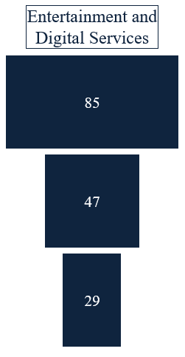
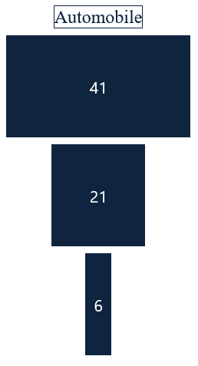
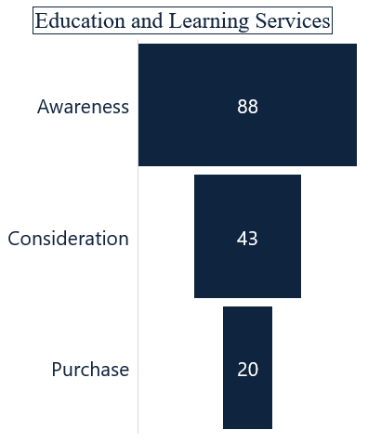
Research Purpose 4/10
FUNNEL (FEMALE) (3)
47%
49%
55%
62%
47%
47%

Slide 21
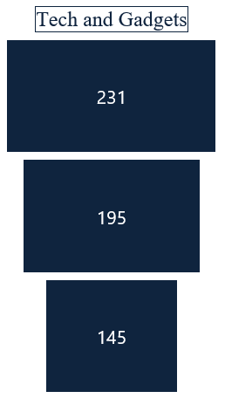
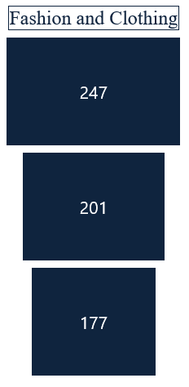
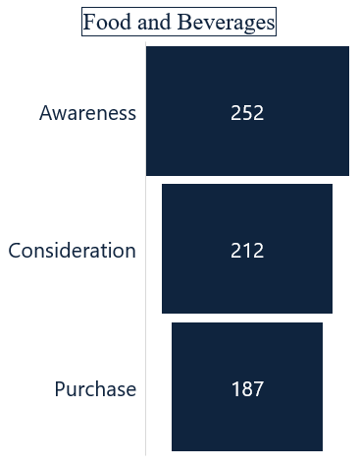
Research Purpose 4/10
FUNNEL (MALE) (1)
84%
81%
84%
74%
88%
88%

Slide 22
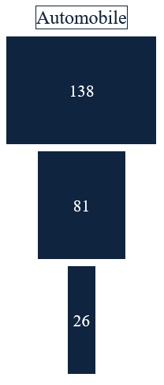
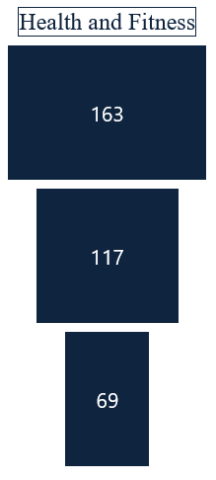
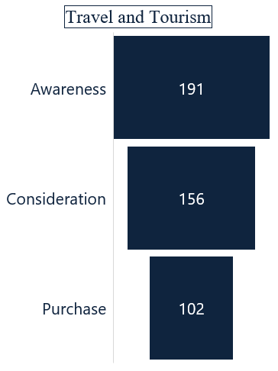
FUNNEL (MALE) (2)
59%
82%
72%
65%
59%
32%

Slide 23
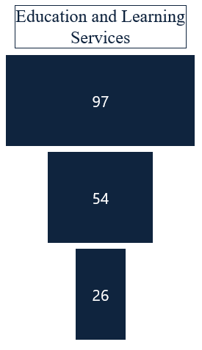
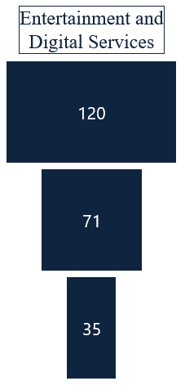
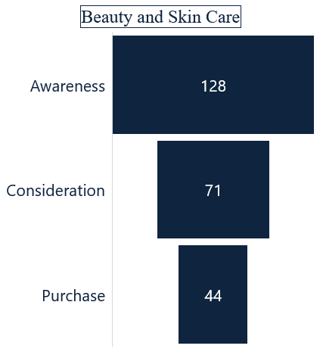
Research Purpose 4/10
FUNNEL (MALE) (3)
56%
55%
59%
62%
27%
49%

Slide 24
PERCEPTION TOWARDS INFLUENCER ENDORSEMENT

Slide 25
Research Purpose 4/10
PERCEPTION TOWARDS THE INFLUENCER ENDORSEMENT (OVERALL)
Respondents feel positive about influencer promoting the product and services across all the category.
77% of respondents, aware of health and fitness influencer marketing feel positive about their promotions.

Slide 26
Research Purpose 4/10
PERCEPTION TOWARDS THE INFLUENCER ENDORSEMENT
(GENDER)
Majority of the female respondents feel positive about influencer promoting the product and services across all the category.
Majority of the male respondents feel positive about influencer promoting the product and services across all the category.

Slide 27
TRUST ON INFLUENCER ENDORSEMENT

Slide 28
Research Purpose 4/10
TRUST ON INFLUENCER ENDORSEMENT
Respondents mentioned that influencers in the travel and tourism category are more trustworthy.
72% of respondents, aware of health and fitness influencer marketing stated that they are trustworthy.

Slide 29
Research Purpose 4/10
TRUST ON INFLUENCER ENDORSEMENT
74% of respondents, aware of health and fitness influencer marketing stated that the influencers are trustworthy.
77% of respondents, aware of travel and tourism influencer marketing stated that the influencers are trustworthy.

Slide 30
SOCIAL MEDIA PLATFORM

Slide 31
Research Purpose 4/10
ON WHICH SOCIAL MEDIA PLATFORM THEY FOLLOW INFLUENCER? (OVERALL)
Majority of the respondents follow the influencers across social media like Instagram, YouTube, TikTok and Facebook.
74% of the respondents, follow the influencer on YouTube.

Slide 32
Research Purpose 4/10
ON WHICH SOCIAL MEDIA PLATFORM THEY FOLLOW INFLUENCER? (MALE AND FEMALE)
Majority of the female respondents follow the influencers across social media like Instagram, TikTok and YouTube.
Majority of the male respondents follow the influencers across social media like Instagram, YouTube and Facebook.

Slide 33


THANK YOU
THANK YOU
Avant Garde Solutions Pvt. Ltd.
Sankhamul, Kathmandu, Nepal
+977 1 5242340 | 5912340
info@avantgarde.com.np
www.avantgarde.com.np

