Slide 1

AWARENESS AND CONSIDERATION STUDY ON
EV ADOPTION
Jan, 2025

Slide 2
OBJECTIVES AND METHODOLOGY
Research Objectives
To assess awareness, perceptions, and adoption potential of two-wheeler electric vehicles (EVs) among ICE users, focusing on familiarity, experience, purchase intent, and environmental motivations.
Research Methodology
Length of Interview (LOI)
20 mins approx.
Sample Size
433
Screening Criteria
Buyers who have purchased the two-wheeler (ICE) in the last six months
Data Analysis
Descriptive statistics using Excel
Thematic analysis of open-ended data
Location
Kathmandu
Janakpur
Research Design
Quantitative data with the survey questionnaire with few open-ended questions
Data collection using digital data collection platform
Administered survey with experienced field enumerators
Computer Aided Personal Interview (CAPI) with the respondents
Butwal
Biratnagar/Itahari

Slide 3
FAMILIARITY

Slide 4
Research Purpose 4/10
FAMILIARITY WITH TWO-WHEELER ELECTRIC VEHICLE (EV) (OVERALL)
Most of the respondent are familiar with the two-wheeler electric vehicle
43.42% of the respondents are familiar with the two-wheeler electric vehicle.

Slide 5
Research Purpose 4/10
FAMILIARITY WITH TWO-WHEELER ELECTRIC VEHICLE (EV) (GENDER)
Most of the male respondent were familiar with the two-wheeler electric vehicle
51% of the male respondents were familiar with the two-wheeler electric vehicle.
Male Sample: 377
Female Sample: 56

Slide 6
Research Purpose 4/10
FAMILIARITY WITH TWO-WHEELER ELECTRIC VEHICLE (EV) (AGE)
Most of the respondent from 35-55 age group were familiar with the two-wheeler electric vehicle
Sample
85
197
104
47

Slide 7
Research Purpose 4/10
FAMILIARITY WITH TWO-WHEELER ELECTRIC VEHICLE (EV) (SEC)
Most of the respondent from higher/upper, upper middle and lower middle were familiar with the two-wheeler electric vehicle
Sample
188
126
52
4

Slide 8
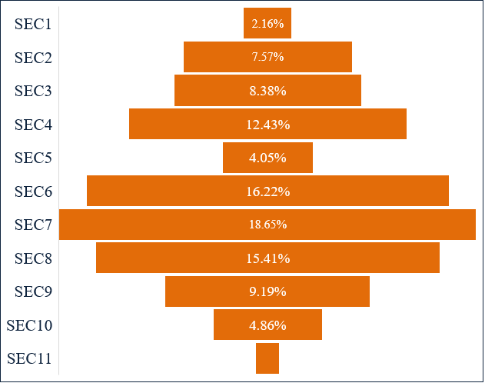
Research Purpose 4/10
SOCIO-ECONOMIC CLASSIFICATION
Majority of the ICE Users (50.81%) were from Higher/Upper Class
SEC | CLASS
SEC 1 - SEC 6 | High / Upper
SEC 7 – SEC 8 | Upper Middle
SEC 9 – SEC 10 | Middle
SEC 11 | Lower Middle
SEC 12 | Lower
SEC 8 – Upper Middle

Slide 9
INFORMATION SOURCE

Slide 10
Research Purpose 4/10
INFORMATION SOURCE OF TWO-WHEELER ELECTRIC VEHICLES (OVERALL)
Majority of the respondent heard about two-wheeler electric vehicle through friends and family
10.62% of respondent heard about two-wheeler electric vehicle through online media

Slide 11
Research Purpose 4/10
INFORMATION SOURCE OF TWO-WHEELER ELECTRIC VEHICLES (GENDER)
Majority of the respondent heard about two-wheeler electric vehicle through friends and family
11.14% of female respondent heard about two-wheeler electric vehicle through online media

Slide 12
Research Purpose 4/10
INFORMATION SOURCE OF TWO-WHEELER ELECTRIC VEHICLES
Majority of the respondent heard about two-wheeler electric vehicle through friends and family
10.62% of respondent heard about two-wheeler electric vehicle through online media

Slide 13
Research Purpose 4/10
INFORMATION SOURCE OF TWO-WHEELER ELECTRIC VEHICLES
Majority of the respondent heard about two-wheeler electric vehicle through friends and family
40% of the middle class respondent heard about two-wheeler electric vehicle through word of mouth

Slide 14
PERCEPTION ON DIFFERENT PARAMETERS

Slide 15
Research Purpose 4/10
EVALUATING PARAMETERS BASED ON THE KNOWLEDGE (OVERALL)
Most respondents have highlighted that EV are equipped with smart features and offer a comfortable riding experience
70% of the users states that it provides better reliability

Slide 16
Research Purpose 4/10
EXPERIENCE WITH TWO-WHEELER EV (OVERALL)
Most respondents have not yet experienced riding a two-wheeler EV but expressed a strong interest in taking a test ride in the near future.
25% of the respondent have driven two- wheeler electric vehicle
Among the 75% who has not driven two-wheeler EV, 74% of them wanted to test ride in the near future

Slide 17
Research Purpose 4/10
CONSIDERATION OF PURCHASING TWO-WHEELER EV IN NEAR FUTURE (OVERALL)
Nearly half of the respondents wanted to purchase two-wheeler electric vehicle due to cost efficiency.
Among 41% who wanted to purchase two- wheeler electric vehicle in future, 4% stated due to the convenience charging
41% of the respondent wanted to purchase two- wheeler electric vehicle in future.

Slide 18
Research Purpose 4/10
REASON FOR NOT CONSIDERING PURCHASING ELECTRIC VEHICLE (OVERALL)
The majority of respondents were hesitant to purchase a two-wheeler electric vehicle, stating its unsuitability for long-distance rides as a primary concern.
Among 59% who did not wanted to purchase two-wheeler electric vehicle, 10% stated it was due to charging issues.

Slide 19
ADOPTION OF EV DUE TO ENVIRONMENT POLLUTION

Slide 20
Research Purpose 4/10
ENVIRONMENTAL POLLUTION ENCOURAGE TO ADOPT A TWO-WHEELER ELECTRIC VEHICLE IN THE NEAR FUTURE (OVERALL)
42% of the respondent stated it encourages them to adopt two-wheeler electric vehicle in the near future

Slide 21
Research Purpose 4/10
REASONS TO ADOPT TWO-WHEELER ELECTRIC VEHICLE (OVERALL)
Majority of the respondents stated adopting two-wheeler electric vehicle reduces pollution
Among 42% who stated it encourages them to adopt two-wheeler electric vehicle in the near future, 3% stated it reduces diseases

Slide 22


THANK YOU
THANK YOU
Avant Garde Solutions Pvt. Ltd.
Sankhamul, Kathmandu, Nepal
+977 1 5242340 | 5912340
info@avantgarde.com.np
www.avantgarde.com.np

