Slide 1

Beer brand Equity, consumption Pattern and Consumer Preferences in Kathmandu Valley, Nepal
  June, 2025

Slide 2
Research OBJECTIVES
1
1
To measure the brand equity: Brand Awareness, Functional, Hedonic, Perceived Value, Brand Image, Brand Loyalty and Customer Satisfaction
2
2
To measure the Premium Potential and Repurchase Potential
3
To assess the Net Value Score (NVS) and Net Promoter Score (NPS)
4
To identify the Consumption Pattern and Purchase Decision
5
To identify the Media Consumption Habits
6
To explore the Demographics and Socio-Economic Classification

Slide 3
METHODOLOGY

Slide 4
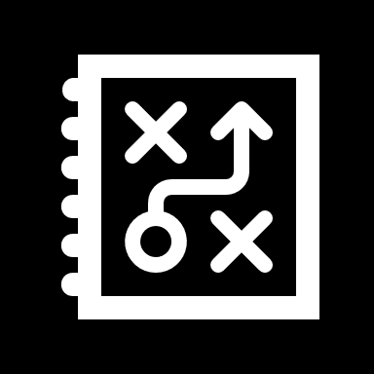
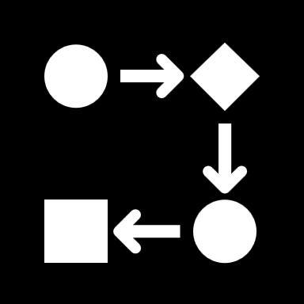
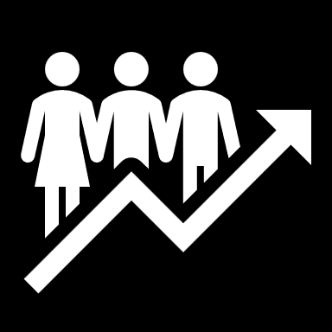
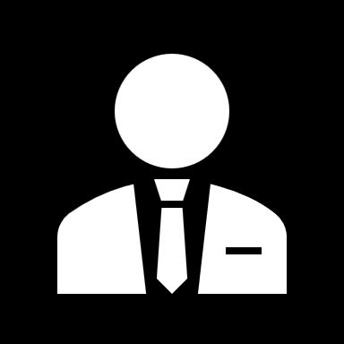
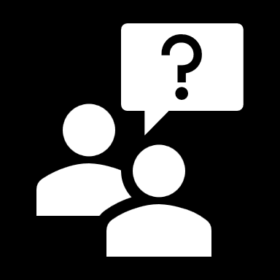
Methodology
1.
2.
Quantitative data generated through a structured survey questionnaire designed to systematically collect data for actionable insights
Scripting, Hosting and Pre-Testing of the survey questionnaire
3.
4.
5.
Data collection conducted using a digital data collection platform to ensure efficiency, accuracy, and real-time monitoring
The survey administered by experienced field enumerators to ensure data quality, respondent engagement, and accurate recording of responses.
Computer Aided Personal Interview (CAPI) with the respondents (Face to Face Interview)
Notes:
CAPI: Computer Assisted Personal Interview

Slide 5
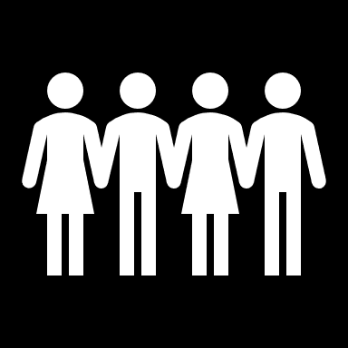
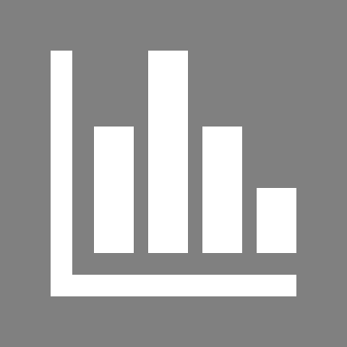
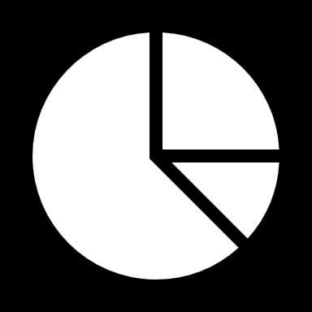
Methodology
Total Sample Size: 508 Beer Consumers
Data Analysis
Margin of error: 5%
Confidence interval: 95%
Design effect: 1.3
Descriptive statistics using Excel
Content Analysis of Qualitative Data
Sampling for Quantitative Survey
Selection of respondents based on screener criteria
Quota sample based on gender
Length of Interview (LOI): 20 mins.
Location: Kathmandu

Slide 6
Screener criteria
1.
Respondents who have purchased and consumed beer in last three months.
Respondents belonging age group above 21
2.
Respondents who do not work in, and do not have household members working in, market research, marketing/ advertising/ public relations, mass media, or the alcohol beverage industry
3.

Slide 7
DEMOGRAPHICS

Slide 8
Demographics

Slide 9
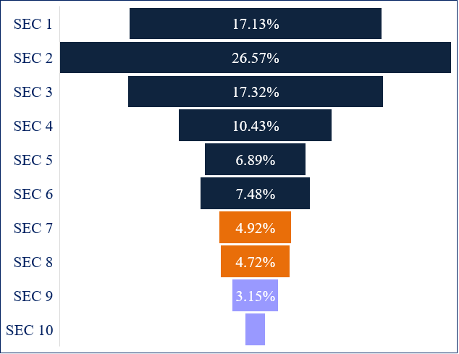
Socio-economic classification of the beer consumers
SEC is calculated based on the chief earner’s occupation and the highest education of male and female in the household

Slide 10
BRAND EQUITY
OF BEER INDUSTRY

Slide 11
Overall Brand equity
Brand image holds higher significance than other brand equity construct
Knowledge
Benefit
Distinct
Customer Satisfaction

Slide 12
Knowledge: Brand Awareness
84% of beer consumers are aware of their brand.

Slide 13
Benefit: Functional and Hedonic
95% of beer consumers find the beer smooth while drinking.
93% of beer consumers feel refreshed after drinking the beer.

Slide 14
Distinct: Perceived value, brand image and brand loyalty
77% of beer consumers state that they are loyal to their brand.
93% of beer consumers state their brand offers good value for money.
97% of beer consumers state their brand is a trusted brand.

Slide 15
Customer SATISFACTION
98% of beer consumers are satisfied with the quality of their brand.

Slide 16
PREMIUM POTENTIAL
AND
REPURCHASE POTENTIAL

Slide 17
premium potential
How likely are you to pay premium for your brand of Beer? Please rate it on a scale of 1 to 5, where "1" being " Very Unlikely " and "5" being " Very Likely "
66.47% of beer consumers are likely to pay premium for their brand of beer

Slide 18
repurchase Potential
How likely are you to repurchase your brand of beer? Please rate it on a scale of 1 to 5, where "1" being " Very Unlikely " and "5" being " Very Likely "
98.22% of beer consumers are likely to repurchase their brand of beer

Slide 19
NET VALUE SCORE (NVS)
AND
NET PROMOTER SCORE (NPS)

Slide 20
NET VALUE SCORE (NVS)
How would you think about the value you are getting from your brand of beer for the price you are paying for it in comparison with similar product from a different beer brand?
69% of the beer consumer stated they are getting better value from their brand of beer for the price they are paying for it in comparison with similar product from a different brand of beer

Slide 21
NET PROMOTER SCORE (NPS)
How likely are you to recommend your brand of beer to your friends, family and colleagues?
Detractor = 7%
Passive = 51.08%
Promoter = 41.81%
Net Promoter Score (NPS) = 34.71%

Slide 22
CONSUMPTION PATTERN
AND
PURCHASE DECISION

Slide 23
preferred beer packaging
Bottle Beer (650 ml) is the highly preferred packaging among the consumers.
Which type of beer packaging do you prefer to consume most often?
20.87% of respondents prefer Can Beer (500ml).

Slide 24
Consumption of beer in one drinking session
Majority of the consumers prefer two bottles or cans in one drinking session.
On average, how many bottles or cans of beer do you consume in one drinking session?
28.94% of respondents prefer three-four bottles or cans in one drinking session.

Slide 25
Purchase location
Majority of the respondents purchase beer from liquor store or beer shop.
Where do you usually purchase beer from?
12.99% of the consumers purchase beer from local convenience store.
Note: The question only specifies the place of purchase, not where the product is purchased and consumed.

Slide 26
Spending on beer per month
Majority of the respondents spend NPR 501-2,000 on beer per month.
On average, how much do you spend on beer per month?
27.36% of the consumers spend NPR 2,001-3,500 on beer per month.

Slide 27
Consumption of beer
Majority of the respondents consume beer Occasionally (special events, gatherings, etc.)
How often do you consume beer?
10.24% of the respondents consume beer once a week.

Slide 28
Preferred alcohol content level
Majority of the respondents prefer 6% alcohol content level.
When choosing a beer, what is your preferred alcohol content level?
11.22% of the respondents prefer 8% alcohol content level.

Slide 29
Companionship to consume beer
Majority of the respondents prefer to consume beer with close friends.
With whom do you usually consume beer?
15% of the respondents prefer to consume beer with their partner/Spouse.

Slide 30
Preferred place to consume beer
Majority of the respondent prefers to consume beer at friend’s/family’s home.
Where do you usually consume beer?
18% of the consumer prefers to consume beer at night club/disco.

Slide 31
Occasion to consume beer
Majority of the respondents consume beer during planned sociable occasion / celebration / big night out.
On what occasions do you usually consume Beer?
13% of the respondents consume beer when watching sports.

Slide 32
Recalled recent activities or events
Majority of the respondent does not recall any recent activities or events.
What recent activities or events do you recall done by the beer?

Slide 33
Attracting promotional offers
Majority of the respondents are attracted by gift vouchers or discount coupons.
Which of the promotional offers is most likely to attract you as a consumer?
4.67% of the respondents are attracted by bottle openers provided by their beer brand

Slide 34
Reasons for consideration
Majority of the respondents consider to consume beer due to pleasant flavour/ taste.
Why did you consider purchasing your brand of beer?
30% of the respondents consider to consume beer their brand due to other people’s recommendations.

Slide 35
Preferred Promotional activities to switch other brands
Majority of the respondents do not switch to other brands.
What promotional offers is likely influence you to switch your current brand to other brands?
4% of the respondents would switch to other brands for better taste.

Slide 36
Get information on Beer
Majority of the respondents get information on beer through word of mouth.
How do you get the information about the beer?
7% of the respondents get information on beer through liquor stores.

Slide 37
effective medium / material to get the information on beer
Majority of the respondents prefer friends as an effective medium to get information on beer.
What can be the effective medium / material to get the information about the beer?
8% of the respondents prefer liquor store as an effective medium to get the information on beer.

Slide 38


THANK YOU
THANK YOU
Avant Garde Solutions Pvt. Ltd.
Sankhamul, Kathmandu, Nepal
info@avantgarde.com.np
www.avantgarde.com.np
+977 1 5242340 | 5912340

