Slide 1

Awareness and Perception of
Influencer Credibility
on Beauty and Skin Care Products
JULY, 2025

Slide 2
OBJECTIVES AND METHODOLOGY
Research Objectives
To understand the influence of beauty and skincare influencers on consumer awareness, perceptions, and purchasing behavior in Nepal, and to assess how these influencer-led promotions shape brand image, trust, and engagement among target audiences.
Research Methodology
Length of Interview (LOI)
30 mins approx.
Location
Kathmandu Valley
Sample Size
400 Females
Age Group
18 - 45
Data Analysis
Descriptive statistics using Excel
Thematic analysis of open-ended data
Research Design
Quantitative data with the survey questionnaire
Data collection using digital data collection platform
Administered survey with experienced field enumerators
Computer Aided Personal Interview (CAPI) with the respondents
Note: This study is internally conducted by Avant Garde Solutions among 400 females in Kathmandu valley, Nepal.

Slide 3
DEMOGRAPHICS

Slide 4
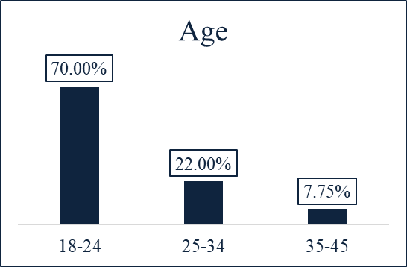
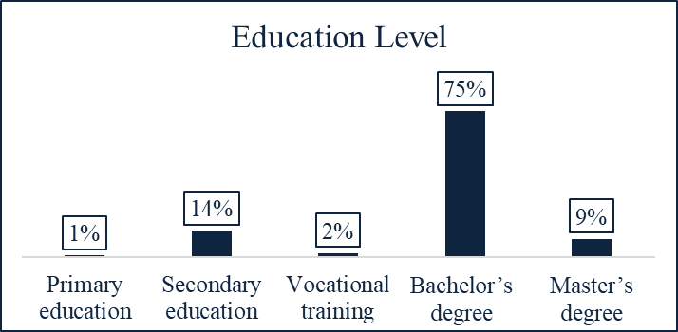
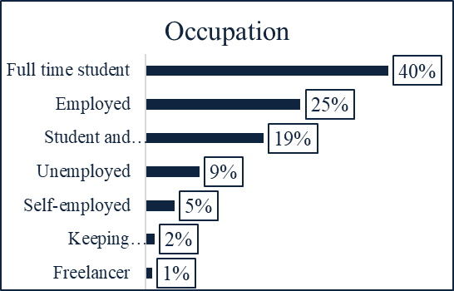
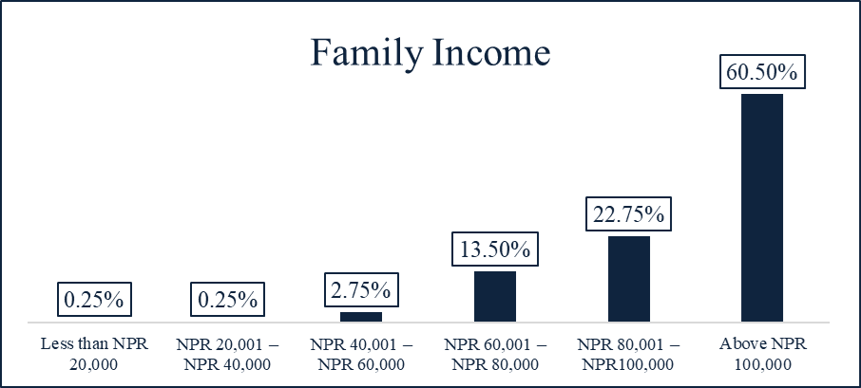
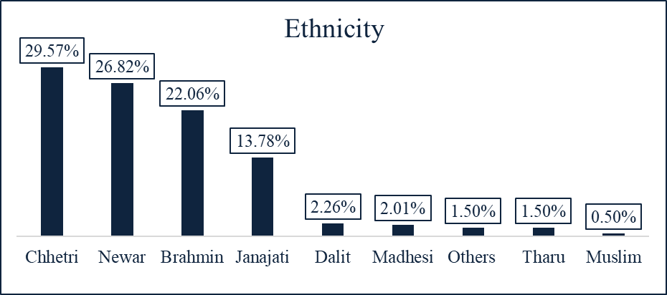
RESEARCH PURPOSE 4/10
DEMOGRAPHICS

Slide 5
SHARE OF MIND

Slide 6
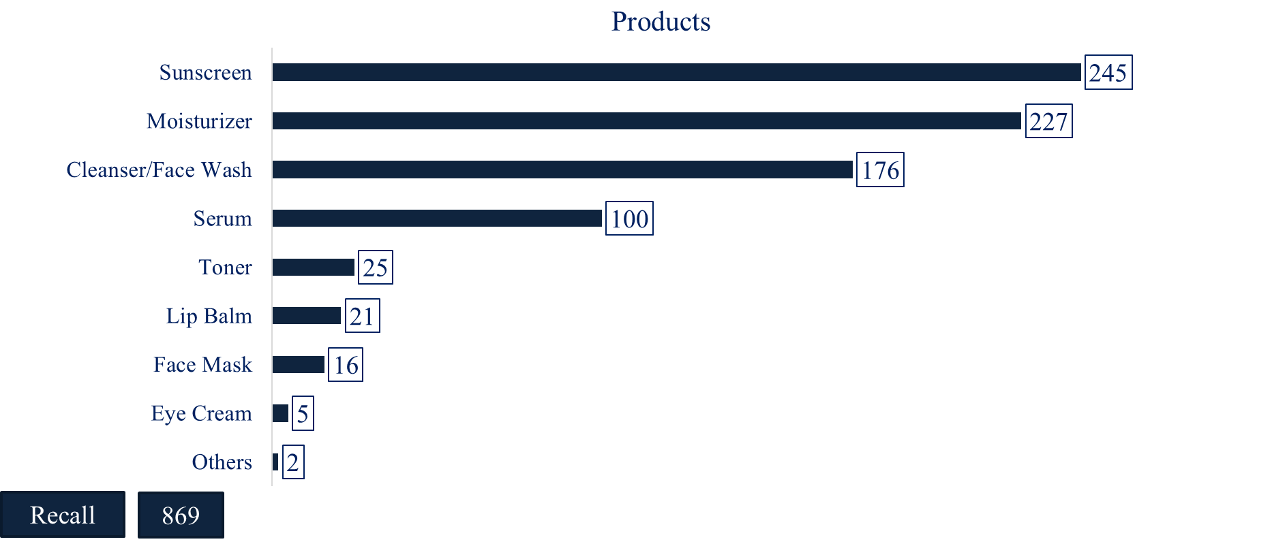
RESEARCH PURPOSE 4/10
AWARENESS ON PRODUCT
Sunscreen is the most used recalled product of different brands influenced by Nepali Influencers.
245 of the respondents recall sunscreen product of different brands influenced by the Nepali influencer.

Slide 7
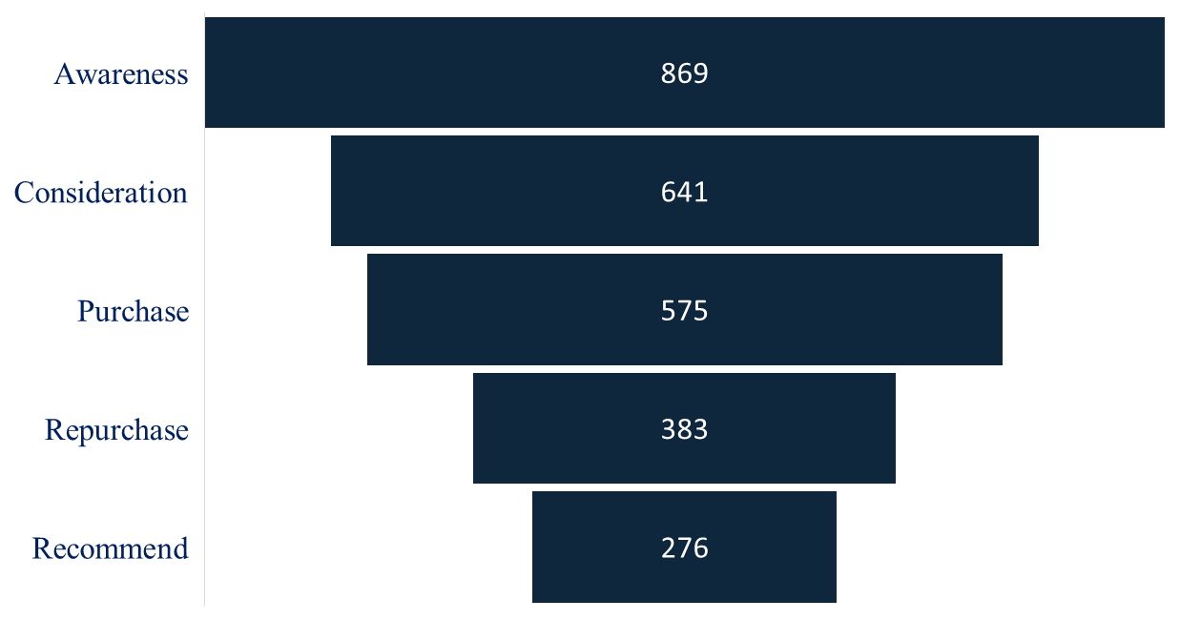
RESEARCH PURPOSE 4/10
FUNNEL
The figure represents that among the 400 respondent who can recall one or more Nepali influencer (869) who have promoted skin care brand, among these, 74% (641) considered making a purchase, and 90% (575) went on to purchase. Among those purchasers, 67% (383) bought the product again, and 72% (276) recommended it to others.
74%
90%
67%
72%

Slide 8
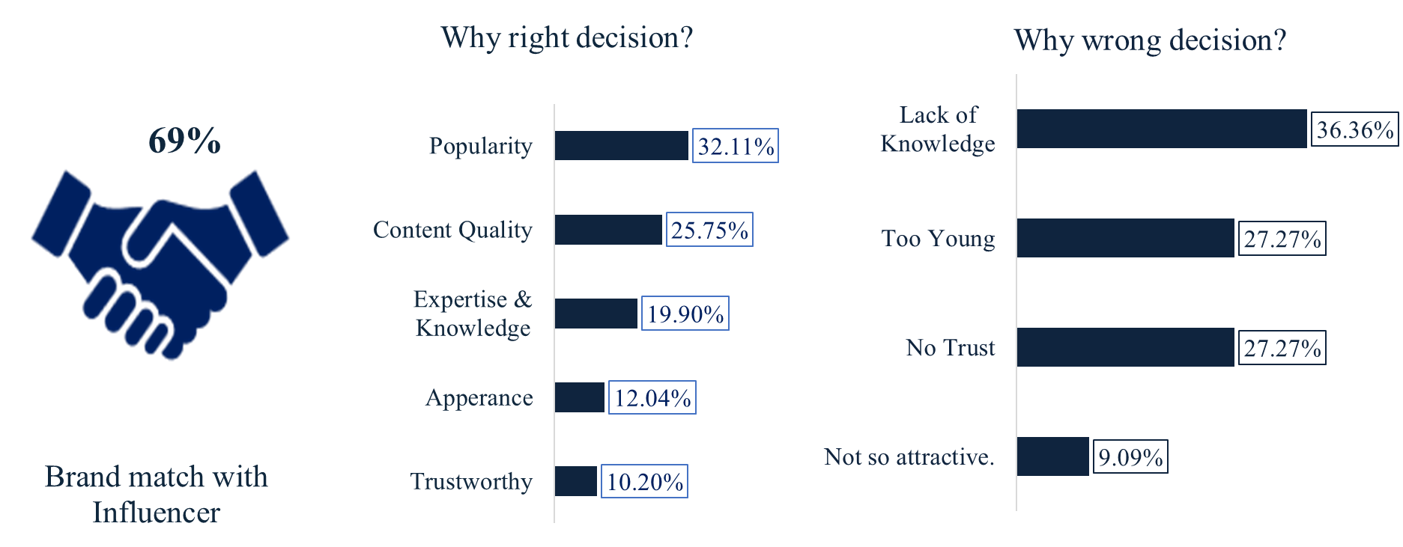

RESEARCH PURPOSE 4/10
BRAND MATCH WITH INFLUENCER
69% of the respondents believe brand selecting the respective influencer was their right decision because of the influencer’s popularity.
Among 69% of the respondents who believe brand selecting influencer was a right decision, 32.11% mentioned due to popularity.
Among 31% of the respondents who believe brand selecting influencer was a wrong decision, 36.36% mentioned due to lack of knowledge.

Slide 9
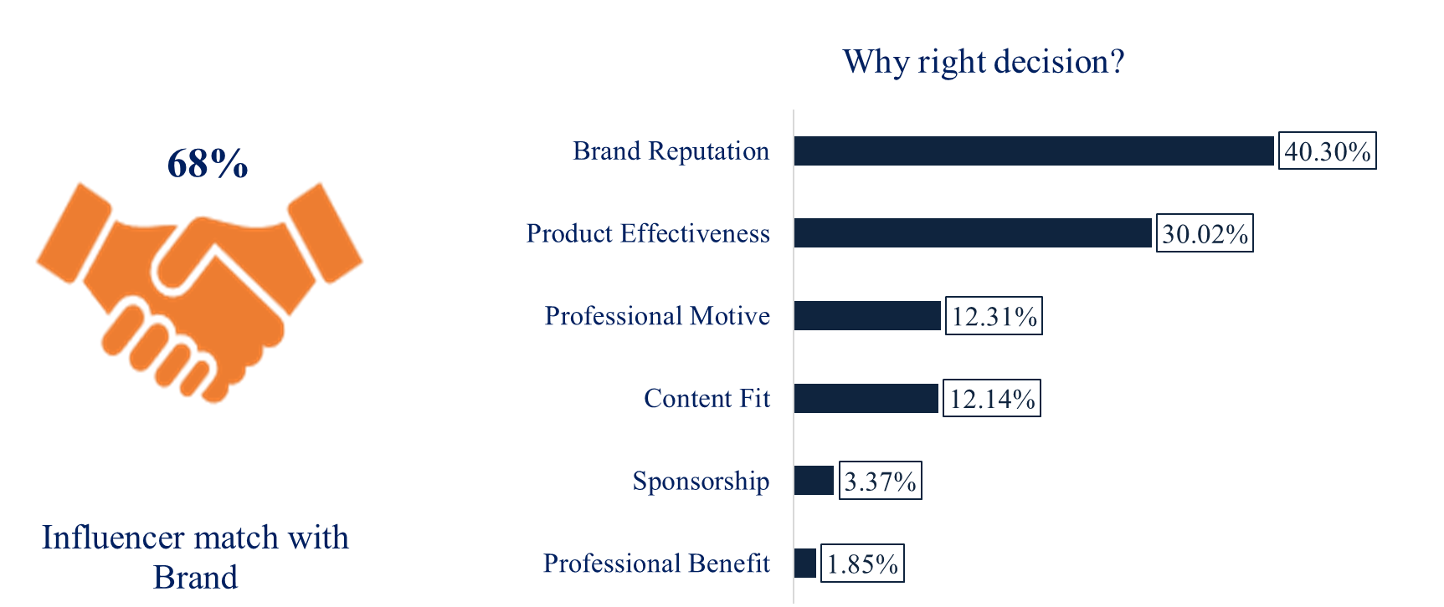
RESEARCH PURPOSE 4/10
INFLUENCER MATCH WITH BRAND
68% of the respondents believe influencer selecting the respective brand was their right decision because of the Brand’s Reputation.
Among 68% of the respondents who believe influencer selecting brand was a right decision, 30.02% mentioned due to product effectiveness.

Slide 10
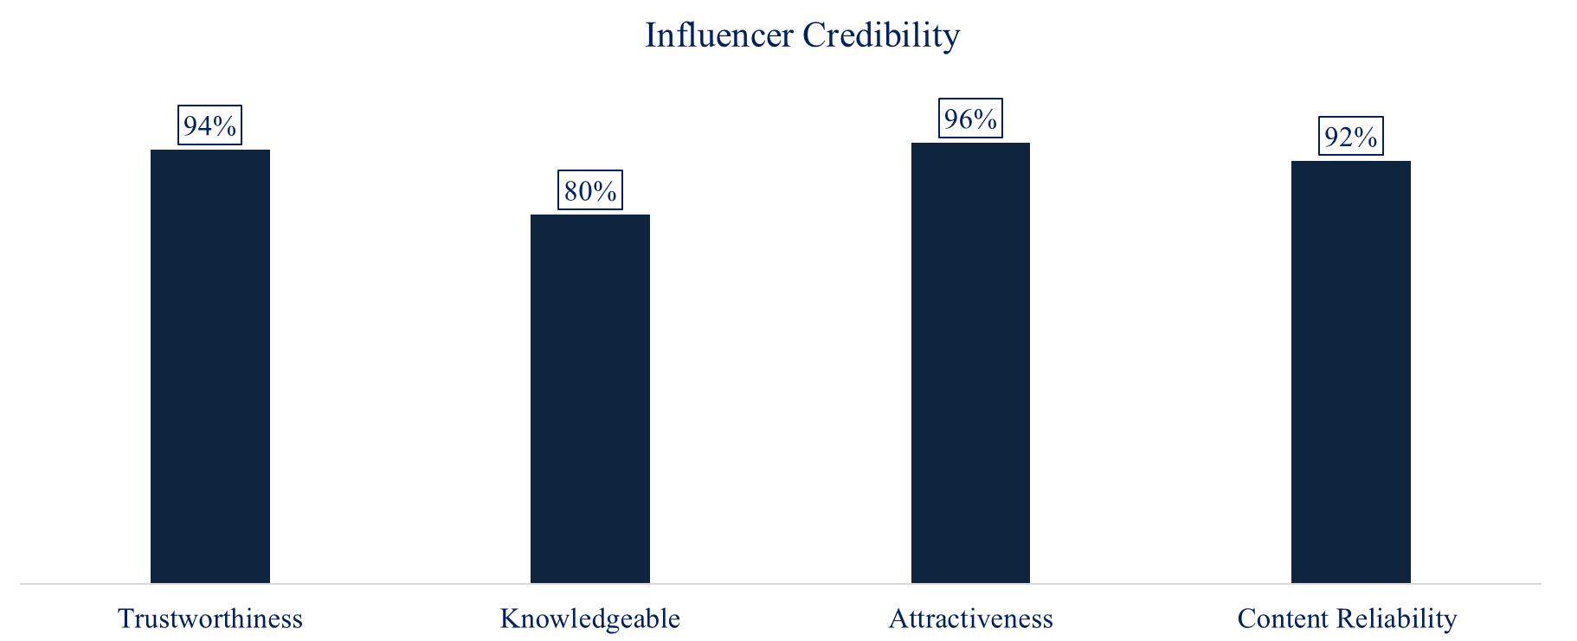
RESEARCH PURPOSE 4/10
INFLUENCER CREDIBILITY
Most of the respondents believe that the influencer’s have high credibility.
Recall
869

Slide 11
MEDIA CONSUMPTION HABITS

Slide 12
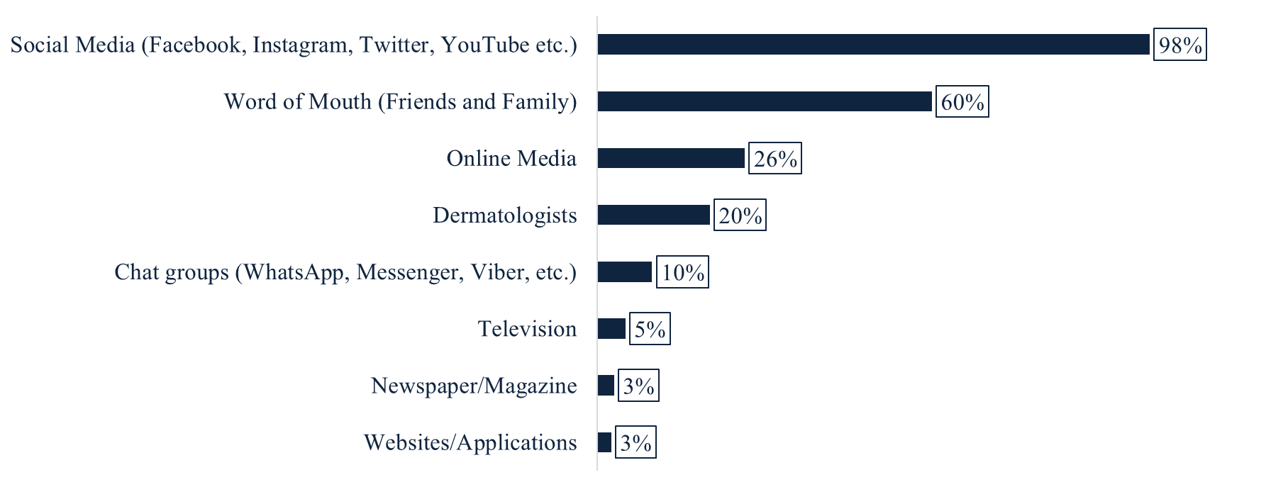
RESEARCH PURPOSE 4/10
MEDIA CONSUMPTION HABIT
Majority of the respondents rely on social media to get information on beauty and skin care product.
98% of the respondents use social media to get information on beauty and skin care product.

Slide 13
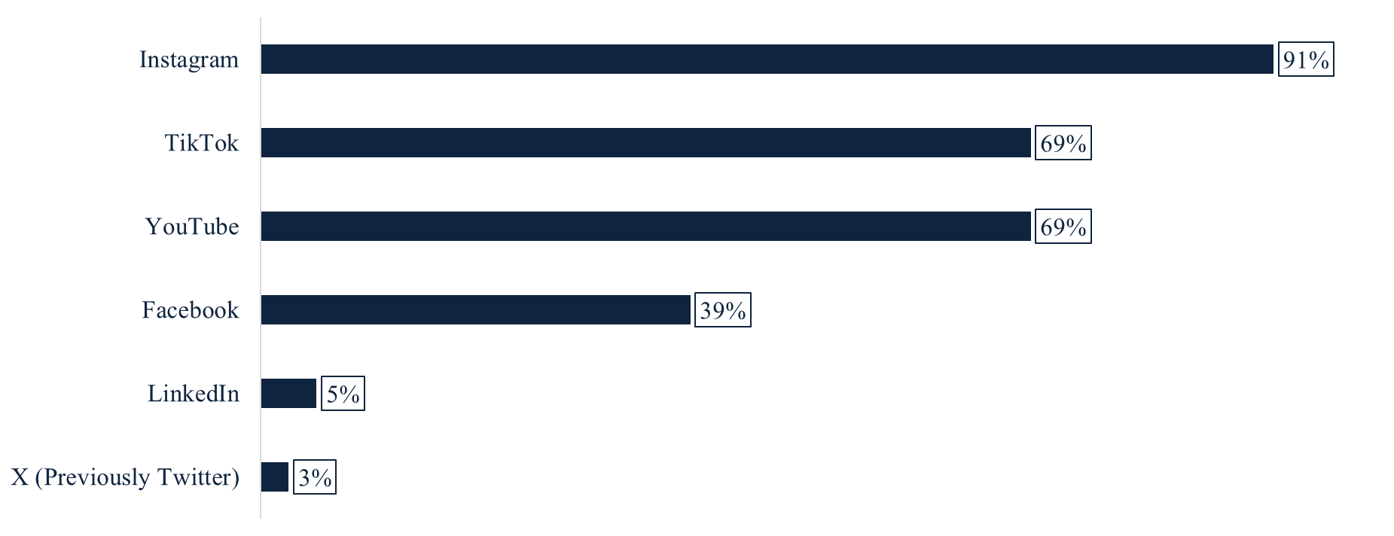
RESEARCH PURPOSE 4/10
MEDIA CONSUMPTION HABIT
Majority of the respondents use Instagram followed by Tiktok and Youtube.
91% of the respondents use Instagram.

Slide 14
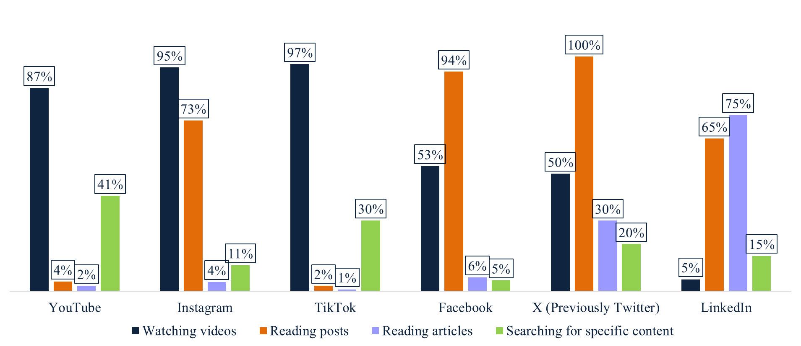
RESEARCH PURPOSE 4/10
MEDIA CONSUMPTION HABIT
Majority of the respondents watch videos and read posts on various social media platforms.
100% of the respondents read posts on X (previously Twitter).

Slide 15
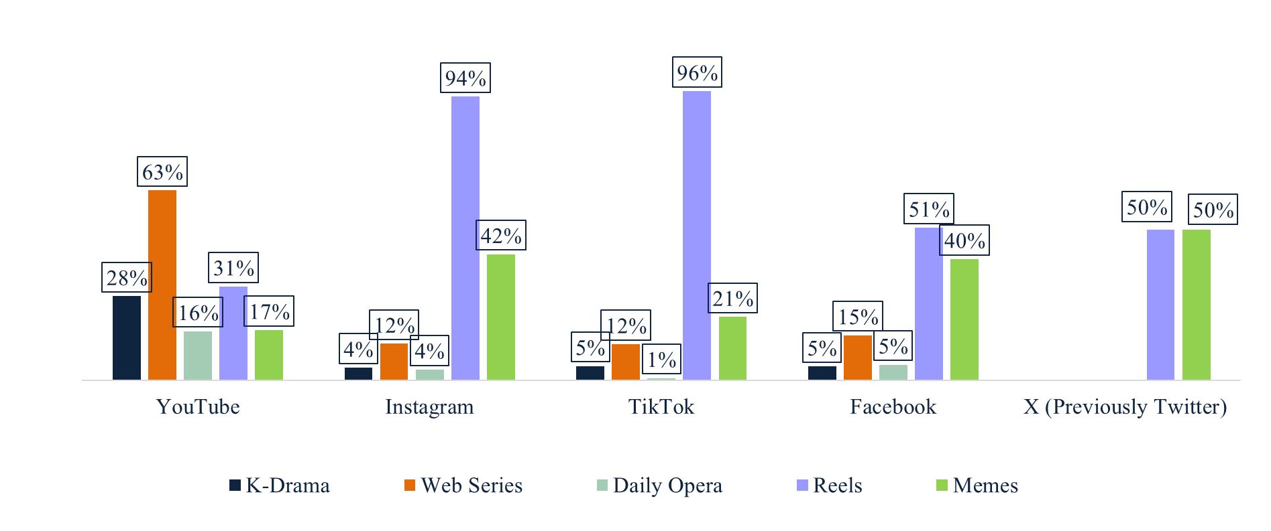
RESEARCH PURPOSE 4/10
MEDIA CONSUMPTION HABIT
Majority of the respondents watch reels on Instagram (94%) and Tiktok (96%) while Youtube is mainly used for web series (63%)
63% of the respondents watches web series in YouTube.

Slide 16
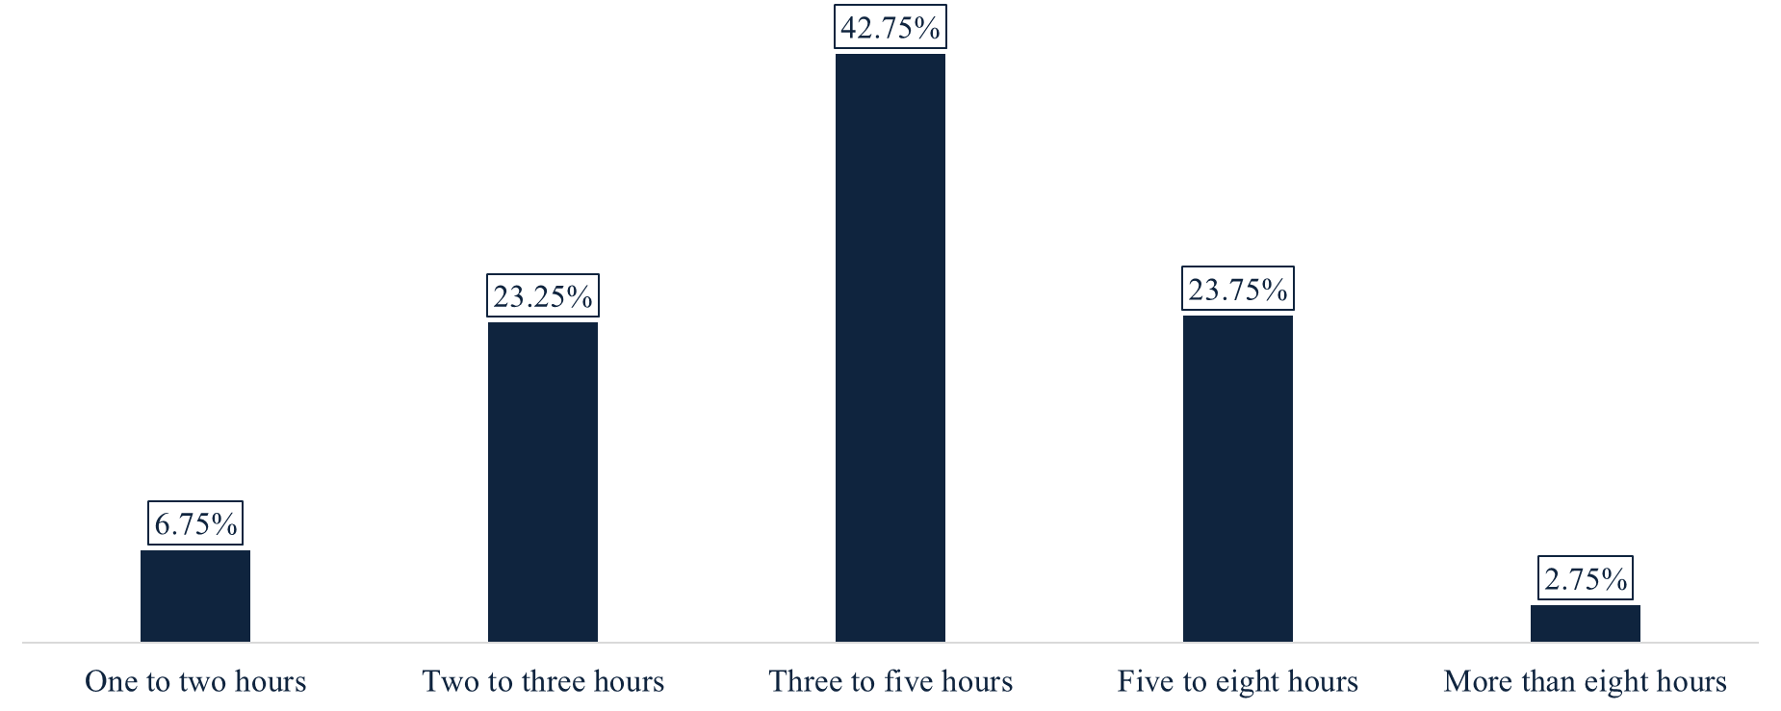
RESEARCH PURPOSE 4/10
MEDIA CONSUMPTION HABIT
Majority of the respondents spend three to five hours daily on social media.
42.75% of the respondents spend three to five hours daily on social media.

Slide 17
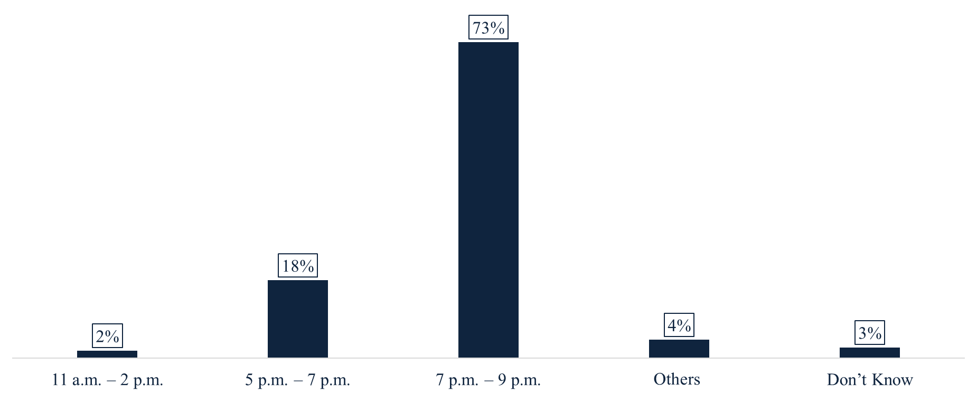
RESEARCH PURPOSE 4/10
MEDIA CONSUMPTION HABIT
Majority of the respondents use social media in between 7 pm to 9 pm.
73% of the respondents use social media in between 7 pm to 9 pm.

Slide 18
THANK YOU
THANK YOU
Avant Garde Solutions Pvt. Ltd.
Sankhamul, Kathmandu, Nepal
+977 1 5242340 | 5912340
info@avantgarde.com.np
www.avantgarde.com.np

