Slide 1

CONUSMER PERCEPTION ON SPONSOR ADVERTISEMENTS ON SOCIAL MEDIA
July, 2025

Slide 2
OBJECTIVES AND METHODOLOGY
Research Objectives
To understand consumer perception, engagement, and purchase behavior influenced by sponsored ads on social media.
Research Methodology
Screening Criteria
Respondent who can recall or recognize sponsor ad on social media
Data Analysis
Descriptive statistics using Excel
Thematic analysis of open-ended data
Location
Kathmandu
Pokhara
Butwal
Janakpur
Length of Interview (LOI)
10 mins approx.
Sample Size
500
Research Design
Quantitative data with the survey questionnaire with few open-ended questions
Data collection using digital data collection platform
Administered survey with experienced field enumerators
Computer Aided Personal Interview (CAPI) with the respondents
Lalitpur
Nepalgunj
Narayanghat

Slide 3
FINDINGS

Slide 4
Research Purpose 4/10
DEMOGRAPHICS

Slide 5
Research Purpose 4/10
FREQUENCY OF NOTICING SPONSORED ADVERTISEMENTS ON SOCIAL MEDIA
A considerable number of respondents sometimes notice sponsored ads while using social media
Question: How often do you notice sponsored advertisements while using social media?
54.20% of the respondents sometimes notice sponsor advertisement while using social media

Slide 6
Research Purpose 4/10
PLATFORMS WITH THE HIGHEST EXPOSURE TO SPONSORED ADVERTISEMENTS
Majority of the respondents see sponsor ads on YouTube followed by Facebook and Instagram
Question: On which platforms do you see the most sponsored ads?
53% of the respondents notice the sponsor advertisement on Instagram

Slide 7
Research Purpose 4/10
TYPES OF SPONSORED ADVERTISEMENTS COMMONLY NOTICED OR REMEMBERED
Majority of the respondents see sponsor ads on about fashion & apparel and food & beverages
Question: What kind of sponsored ads do you usually notice or remember?
52% of the respondents notice the sponsor advertisement related to apps and online services

Slide 8
Research Purpose 4/10
PREFERRED CONTENTS OF SPONSOR ADS
Majority of the respondents prefers sponsor ads on discount/offers followed by customer reviews
Question: Which contents of sponsor ads do you prefer the most?
48% of the respondents prefers sponsor advertisement on product/services

Slide 9
Research Purpose 4/10
GENERAL PERCEPTION OF SPONSORED ADS ON SOCIAL MEDIA
Majority of the respondents feels the sponsor ads are distracting followed by informative and irritating
Question: How do you generally feel about sponsor ads on social media?
53% of the respondents finds the sponsor advertisement relevant

Slide 10
Research Purpose 4/10
GENERAL PERCEPTION OF SPONSORED ADS ON SOCIAL MEDIA
Question: How do you generally feel about sponsor ads on social media?

Slide 11
Research Purpose 4/10
FREQUENCY OF CLICKING SPONSORED ADS ON SOCIAL MEDIA
Moderate number of respondents have clicked the sponsor ads on social media
Question: How often do you click the sponsor ads on social media?
52% of the respondents have clicked sponsor advertisement on social media

Slide 12
Research Purpose 4/10
FREQUENCY OF CLICKING SPONSORED ADS ON SOCIAL MEDIA
Question: How often do you click the sponsor ads on social media?
57% of the respondents often clicked the sponsor advertisement related to food & beverages

Slide 13
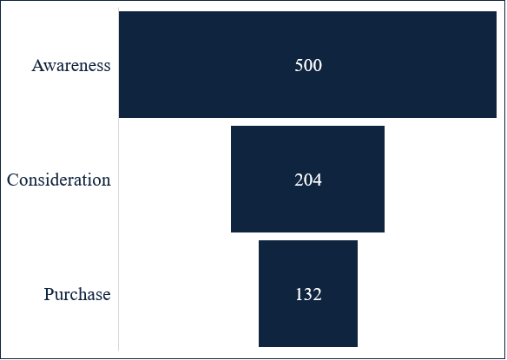
Research Purpose 4/10
FUNNEL
The figure represents that among the 500 respondent who can recall and recognize the sponsor ads, 40.8% (204) of the respondents considered purchasing in the last six months and among them 64.7% (132) have purchased in the last six months
40.8%
Among 132 respondent who have purchased something being influenced by the sponsor ads in the last six months, 26% of the respondents stated they have purchased beauty products
64.7%

Slide 14
FINDINGS
BASED ON
DEMOGRAPHICS

Slide 15
Research Purpose 4/10
FREQUENCY OF NOTICING SPONSORED ADVERTISEMENTS ON SOCIAL MEDIA
Majority of the respondent from all age group notice sponsor ads while using social media
Question: How often do you notice sponsored advertisements while using social media?
51.49% of the 18-25 age group respondents sometimes notice sponsor advertisement while using social media

Slide 16
Research Purpose 4/10
FREQUENCY OF NOTICING SPONSORED ADVERTISEMENTS ON SOCIAL MEDIA
Both male and female respondent notices sponsor ads while using social media
Question: How often do you notice sponsored advertisements while using social media?
52.05% of the male respondents sometimes notice sponsor advertisement while using social media

Slide 17
Research Purpose 4/10
PLATFORMS WITH THE HIGHEST EXPOSURE TO SPONSORED ADVERTISEMENTS
Respondents from all age group see sponsor ads on YouTube followed by Facebook
Question: On which platforms do you see the most sponsored ads?
50% of the 26-35 age group respondents notice the sponsor advertisement on Instagram

Slide 18
Research Purpose 4/10
PLATFORMS WITH THE HIGHEST EXPOSURE TO SPONSORED ADVERTISEMENTS
Both male and female respondent see sponsor ads on highly on YouTube
Question: On which platforms do you see the most sponsored ads?
55% of the female respondents notice the sponsor advertisement on Instagram

Slide 19
Research Purpose 4/10
TYPES OF SPONSORED ADVERTISEMENTS COMMONLY NOTICED OR REMEMBERED
Majority of the respondents from all age group notice sponsor ads on fashion & apparel
Question: What kind of sponsored ads do you usually notice or remember?
55% of the 26-35 age group respondents notice the sponsor advertisement related to personal care and beauty

Slide 20
Research Purpose 4/10
TYPES OF SPONSORED ADVERTISEMENTS COMMONLY NOTICED OR REMEMBERED
Majority of the male respondents notice sponsor ads on electronic and gadget whereas female respondent notice sponsor ads on fashion & apparel
Question: What kind of sponsored ads do you usually notice or remember?
71% of the female respondents notice the sponsor advertisement related to personal care and beauty

Slide 21
Research Purpose 4/10
PREFERRED CONTENTS OF SPONSOR ADS
Majority of the respondents from all age group prefers sponsor ads on discount/offers
Question: Which contents of sponsor ads do you prefer the most?
50% of the 36-45 age group respondents prefers sponsor advertisement on customer reviews

Slide 22
Research Purpose 4/10
PREFERRED CONTENTS OF SPONSOR ADS
Both the male and female respondents prefers sponsor ads on discount/offers
Question: Which contents of sponsor ads do you prefer the most?
54% of the female respondents prefers sponsor advertisement on customer reviews

Slide 23
Research Purpose 4/10
GENERAL PERCEPTION OF SPONSORED ADS ON SOCIAL MEDIA
Respondents from all the age group feels the sponsor ads are distracting followed by informative and useful
Question: How do you generally feel about sponsor ads on social media?
60% of the 26-35 age group respondents finds the sponsor advertisement relevant

Slide 24
Research Purpose 4/10
GENERAL PERCEPTION OF SPONSORED ADS ON SOCIAL MEDIA
Majority of the male respondents feels the sponsor ads are distracting followed by informative
Question: How do you generally feel about sponsor ads on social media?
52% of the female respondents finds the sponsor advertisement relevant

Slide 25
Research Purpose 4/10
FREQUENCY OF CLICKING SPONSORED ADS ON SOCIAL MEDIA
Moderate number of respondents have clicked the sponsor ads on social media
Question: How often do you click the sponsor ads on social media?
59.50% of 26-35 age group respondents have clicked sponsor advertisement on social media

Slide 26
Research Purpose 4/10
FREQUENCY OF CLICKING SPONSORED ADS ON SOCIAL MEDIA
Moderate number of respondents have clicked the sponsor ads on social media
Question: How often do you click the sponsor ads on social media?
49.61% of female respondents have clicked sponsor advertisement on social media

Slide 27
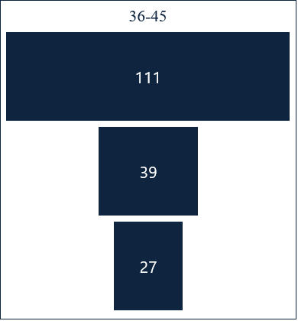
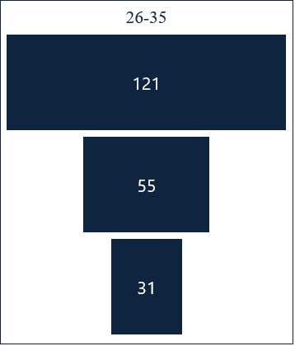
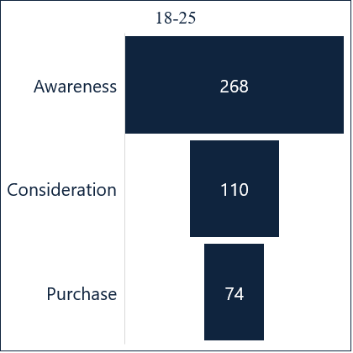
Research Purpose 4/10
AGE WISE FUNNEL
The figure represents that among the 268 respondent from age group 18-25 who can recall and recognize the sponsor ads, 41% (110) of the respondents considered purchasing in the last six months and among them 67.27% (74) have purchased in the last six months
41%
45.45%
35.13%
69.23%
67.27%
56.36%

Slide 28
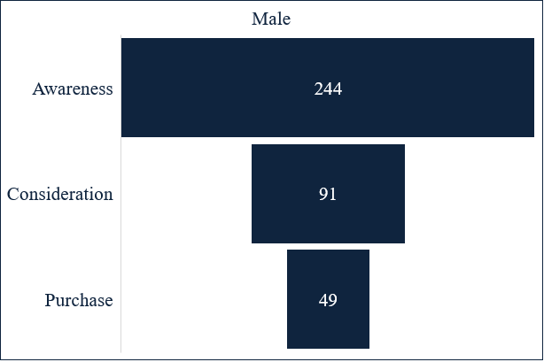
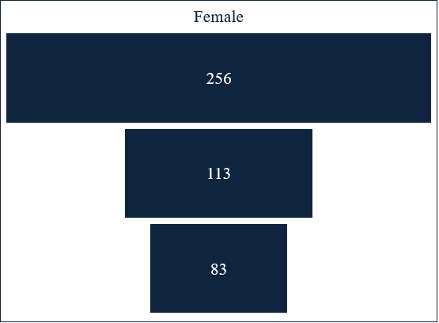
Research Purpose 4/10
GENDER WISE FUNNEL
The figure represents that among the 244 male respondent who can recall and recognize the sponsor ads, 37.29% (91) of the respondents considered purchasing in the last six months and among them 53.84% (49) have purchased in the last six months
44.14%
37.29%
73.45%
53.84%

Slide 29
Research Purpose 4/10
PURCHASE IN THE LAST SIX MONTHS
What have you purchased being influenced by the sponsor ads on social media in the last six months?

Slide 30
Research Purpose 4/10
PURCHASE IN THE LAST SIX MONTHS
What have you purchased being influenced by the sponsor ads on social media in the last six months?
Among 83 of the female respondent who have purchased something being influenced by the sponsor ads in the last six months, 36% of the respondents stated they have purchased clothes
Among 49 of the male respondent who have purchased something being influenced by the sponsor ads in the last six months, 8% of the respondents stated they have purchased shoes

Slide 31


THANK YOU
THANK YOU
Avant Garde Solutions Pvt. Ltd.
Sankhamul, Kathmandu, Nepal
+977 1 5242340 | 5912340
info@avantgarde.com.np
www.avantgarde.com.np

