Slide 1

Physical Bank visits
And
digital banking adoption among
gen-z users
  January, 2026

Slide 2
Research OBJECTIVES
1
1
To understand customers’ banking habits and frequency of bank visits among saving account holders.
2
2
To assess the adoption and usage of mobile banking applications.
3
To examine the effect of digital banking on physical bank visit behavior.
4
To evaluate customer satisfaction and security perception towards mobile banking services.
5
To identify customer expectations for improvement in mobile banking applications.

Slide 3





Methodology
1.
2.
Quantitative data generated through a structured survey questionnaire designed to systematically collect data for actionable insights
Scripting, Hosting and Pre-Testing of the survey questionnaire
3.
4.
5.
Data collection conducted using a digital data collection platform to ensure efficiency, accuracy, and real-time monitoring
The survey administered by experienced field enumerators to ensure data quality, respondent engagement, and accurate recording of responses.
Computer Aided Personal Interview (CAPI) with the respondents (Face to Face Interview)
Notes:
CAPI: Computer Assisted Personal Interview

Slide 4

Methodology AND SCREENER CRITERIA
Total Sample Size: 400
Data Analysis
Margin of error: 5%
Confidence interval: 95%
Design effect: 1.04
Descriptive statistics using Excel
Content Analysis of Qualitative Data
Screener Criteria
Sampling for Quantitative Survey
Selection of respondents based on screener criteria
Quota sample based on gender
Maintains saving account at a commercial bank.
Have not availed a loan from a commercial bank.
Does not visit the bank for own business transactions.
Does not visit the bank on behalf of the organization where he/she is employed.
Length of Interview (LOI): 10 mins.
Location: Kathmandu Valley

Slide 5
FINDINGS

Slide 6
Demographics
Majority of the respondents belong to the age group 18-24, with an equal representation of males and females and a majority of single respondents.
27.5% of the respondents belong to the age group 25-28

Slide 7
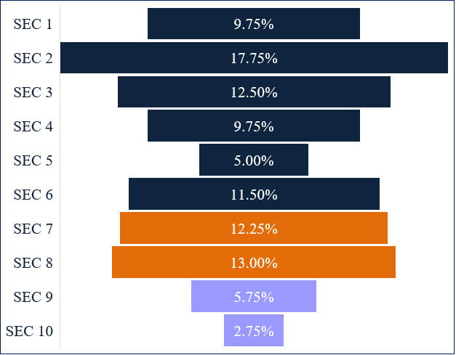
Socio-economic classification (SEC) of the digital banking users
Majority of the respondents belong to the Higher/Upper SEC category.
25.25% of the respondents belongs to Upper Middle Class

Slide 8
PURPOSE OF USING saving account
Majority of the respondents use their saving account mainly for saving purpose.
For what purpose do you use your saving account?
91% of the respondents use saving account mainly for saving purpose

Slide 9
Frequency of bank VISIT
Majority of the respondents visit bank only when required.
How frequently do you visit your bank?
12% of the respondents visit bank once in six months.

Slide 10
PURPOSE OF BANK VISIT
Majority of the respondents visit their bank for the purpose of depositing or withdrawing money.
What are the main purposes of your bank visits?
Among 95% of the respondents who visit the bank, 78% visited for depositing/withdrawing money

Slide 11
RECENT BANK VISIT
Majority of the respondents visited their bank within last six months
When was your last visit to your bank?
Among 95% of the respondents who visited the bank, 18% visited within last three months

Slide 12
Purpose OF last BANK VISIT
Majority of the respondents’ last bank visit was for the purpose of depositing or withdrawing money.
Considering your last visit to your bank, what was the purpose?
Among 95% of the respondents who visited the bank, 63% deposited or withdraw money during their last visit

Slide 13
Frequency of bank visits in the last three months
Majority of the respondents visited their primary bank 1-2 times in the last three months.
In the last three months, how many times did you visit your primary bank?
Among 54% of the respondents who visited the bank in the last three months, 71% visited 1-2 times during the time

Slide 14
REASON FOR NOT VISITING THE BANK in the last three months
Majority of the respondents didn’t find any need to visit the bank in the past three months.
Why didn’t you visit the bank in the past three months?
Among 41% of the respondents didn’t visit the bank in the last three months, 76% find no need/managed transactions through mobile banking

Slide 15
Usage of digital banking
Majority of the respondents use the mobile banking application, while few use the web version of mobile banking.
3% of the respondents use the web version mobile banking application.
97% of the respondents use the mobile banking application.

Slide 16
Reason for using or not using mobile banking
Majority of the respondents use mobile banking for money transfer, whereas majority of respondents don’t use mobile banking due to lack of familiarity.
Among 97% of respondents who use the mobile banking application, 59% of them use it for utility payment
Among 3% of respondents who don’t use the mobile banking application, 73% of them are unfamiliar with it

Slide 17
INTENT TO USE or not use MOBILE banking APPLICATION
Majority of the respondents intend to use the mobile banking application because it is easy, convenient to use anytime and anywhere. Whereas, majority do not intend to use due to lack of familiarity.
Among 3% of respondents who don’t use the mobile banking application, 73% of them intent to use it in near future

Slide 18
CHANGES IN BANK VISITS DUE TO MOBILE BANKING
Majority of the respondents’ bank visits have decreased due to mobile banking.
Has your bank visit increases, decreases or remains the same due to mobile banking?
3% of the respondents’ bank visits have increased due to mobile banking

Slide 19
Reasons for changes iN BANK VISITS
Majority of the respondents’ bank visits have increased due to money deposits, decreased due to mobile app services.
Why do you think so?
Among 3% of respondents whose bank visits have increased, 100% was for the purpose of depositing money
Among 86% of the respondents whose bank visit has decreased, 29% of them reported that this was due to mobile banking

Slide 20
Satisfaction with mobile banking application
Majority of the respondents are satisfied with their mobile banking application.
How satisfied are you with your mobile banking application?
19% of the respondents were extremely satisfied with their mobile banking application

Slide 21
Reason for dissatisfaction with mobile banking application
Majority of the respondents are dissatisfied with their mobile banking application due to technical/server error.
Why are you dissatisfied with mobile banking application?
Among 4% of the dissatisfied respondents, 62% of them reported technical/server error as the reason

Slide 22
Security with mobile banking application
Majority of the respondents feel secure with their mobile banking application.
How secure do you feel with your mobile banking application?
16% of the respondents feel their mobile banking application extremely secure

Slide 23
Reason for insecurity with mobile banking application
Majority of the respondents feel insecure with their mobile banking application due to data theft.
Why do you feel insecure with mobile banking application?
Among 1% of the respondents who feel insecure with their mobile banking application, 2% of them reported constant change in password as the reason

Slide 24
Changes in future bank visits
Majority of the respondents’ future bank visits are expected to decrease for their current banking service requirement.
In the near future, do your bank visit increase, decrease or remains the same for your current banking service requirements?
3% of the respondents' future bank visits are expected to increase for their current banking service requirement

Slide 25
Expected features in mobile banking
Majority of the respondents stated that no changes are required in their mobile banking application.
What further features do you expect from your current mobile banking application?
60% of the respondents stated that no changes are required in their mobile banking application.

Slide 26


THANK YOU
THANK YOU
Avant Garde Solutions Pvt. Ltd.
Sankhamul, Kathmandu, Nepal
info@avantgarde.com.np
www.avantgarde.com.np
+977 1 5242340 | 5912340

