Slide 1

GEN Z PERCEPTION
ON
INFLUENCER MARKETING
  July, 2026

Slide 2
OBJECTIVES AND METHODOLOGY
Research Objectives
To analyze consumer engagement, trust, and purchasing behavior influenced by influencers across various product categories and platforms.
Research Methodology
Length of Interview (LOI)
20 mins approx.
Location
Kathmandu Valley
Sample Size: 630
Age Group
18 – 28
Field Work: May to June, 2026
Data Analysis
Descriptive statistics using Excel
Thematic analysis of open-ended data
Research Design
Quantitative data with the survey questionnaire
Data collection using digital data collection platform
Administered survey with experienced field enumerators
Computer Aided Personal Interview (CAPI) with the respondents
Note: This study is internally conducted by Avant Garde Solutions among Gen Z in Kathmandu valley, Nepal.

Slide 3
FINDINGS

Slide 4
Demographics
Majority of the respondents belong to the age group 18-24 and are unmarried.

Slide 5
RECALL & RECOGNITION OF VARIOUS CATEGORIES ENDORSED
BY
INFLUENCERS

Slide 6
TOM SPON AIDED (OVERALL)
Food and Beverages leads in top of mind, spontaneous and aided recall, suggesting they have strong awareness on the category.
104 specifically mention Food and Beverages as the initial category that comes to mind endorsed by influencer, while 155 recall it, and a total of 191 recognize.

Slide 7
TOM SPON AIDED (MALE AND FEMALE)
Food and Beverages leads in spontaneous among male, while beauty and skincare products leads in top of mind among female.
269
Sample Size
315
315

Slide 8
FUNNEL ON VARIOUS CATEGORIES
ENDORSED
BY
INFLUENCERS

Slide 9
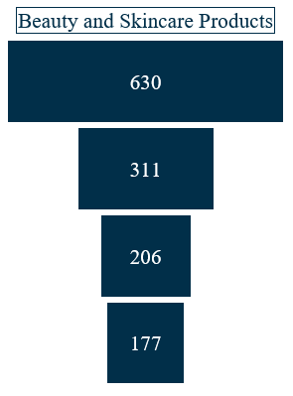
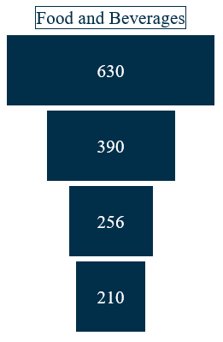
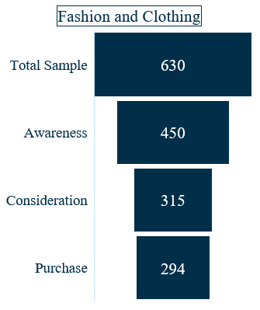
FUNNEL (OVERALL) (1)
71%
62%
49%
70%
66%
66%
82%
86%
93%
Awareness: Category / products and services that come to consumers’ mind first, endorsed by an influencer.
Consideration: Category / products and services that consumers consider buying, endorsed by an influencer.
Purchase: Category / products and services that consumers actually purchase, endorsed by an influencer.

Slide 10
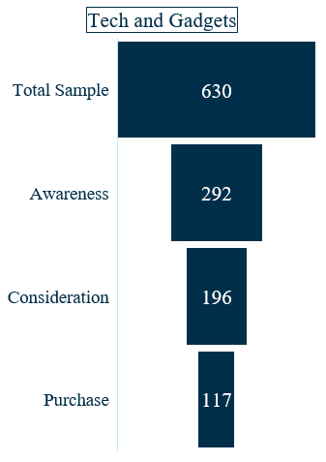
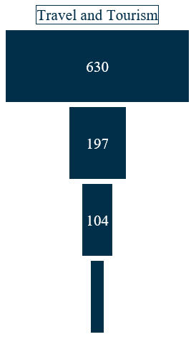
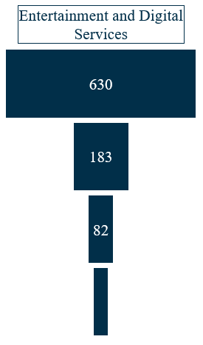
FUNNEL (OVERALL) (2)
46%
31%
29%
67%
53%
45%
60%
44%
59%

Slide 11
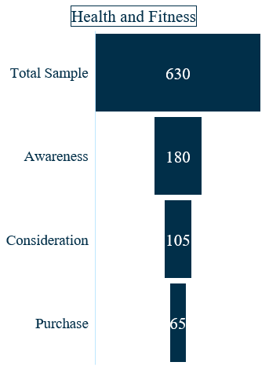
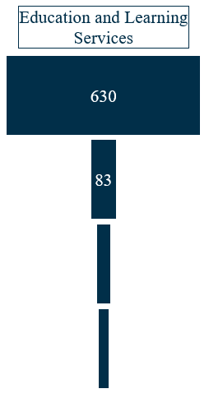
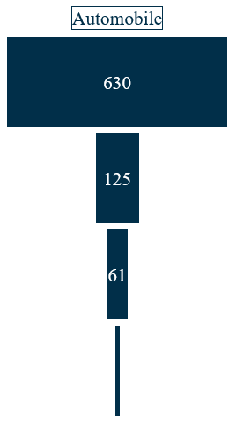
FUNNEL (OVERALL) (3)
29%
20%
13%
58%
49%
54%
62%
25%
78%

Slide 12
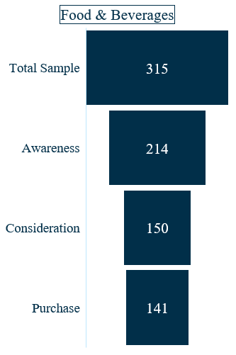
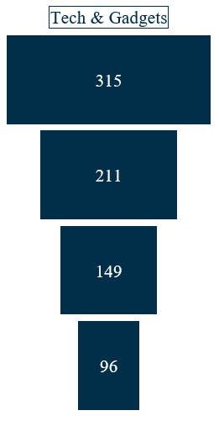
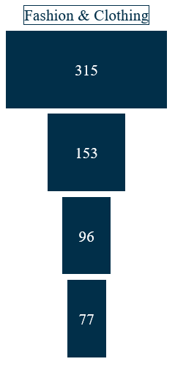
FUNNEL (MALE) (1)
68%
67%
49%
71%
63%
70%
94%
64%
80%

Slide 13
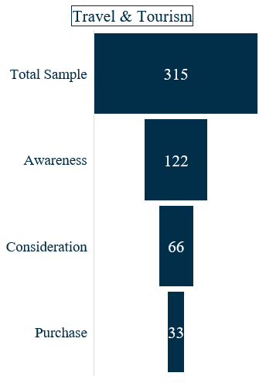
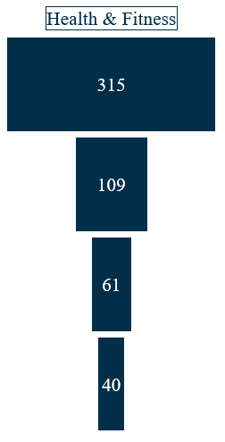
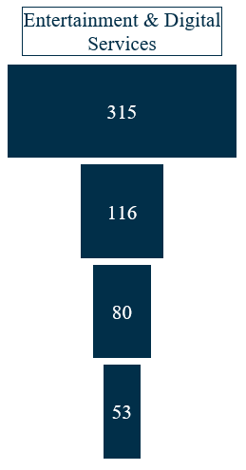
FUNNEL (MALE) (2)
39%
37%
35%
54%
69%
56%
50%
66%
66%

Slide 14
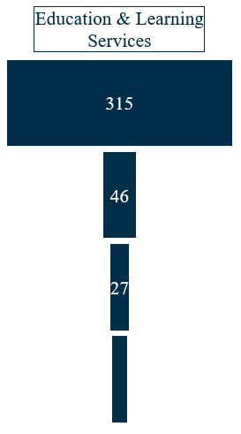
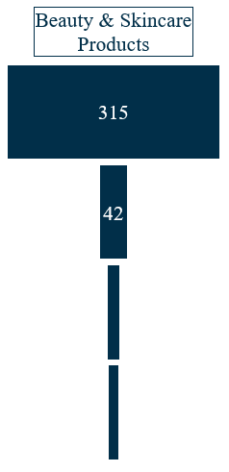
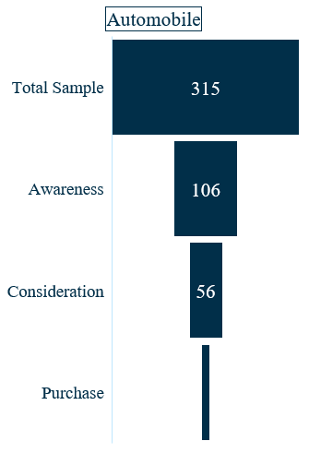
FUNNEL (MALE) (3)
34%
15%
13%
53%
59%
45%
25%
85%
89%

Slide 15
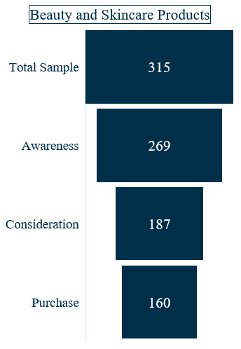
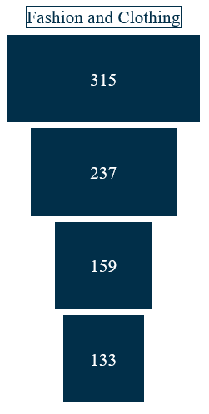
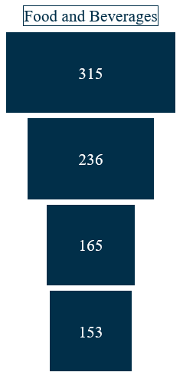
FUNNEL (FEMALE) (1)
85%
75%
75%
70%
67%
70%
86%
84%
93%

Slide 16
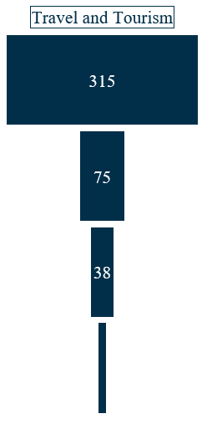
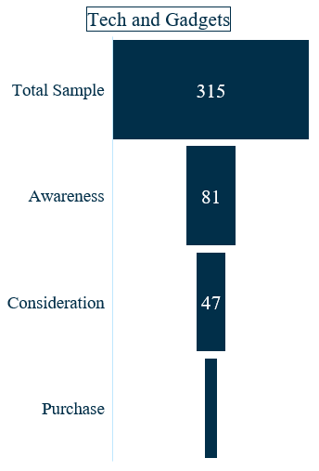
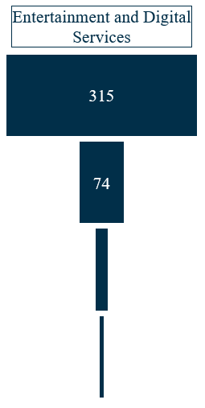
FUNNEL (FEMALE) (2)
26%
24%
24%
58%
51%
28%
45%
34%
38%

Slide 17
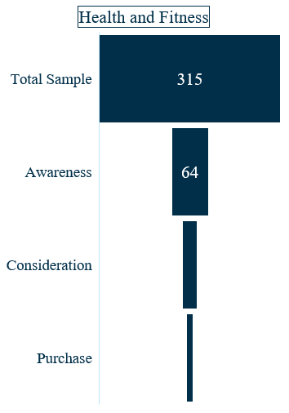
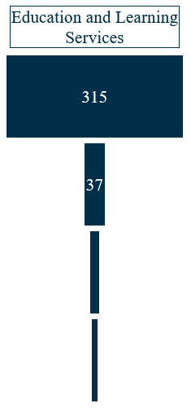
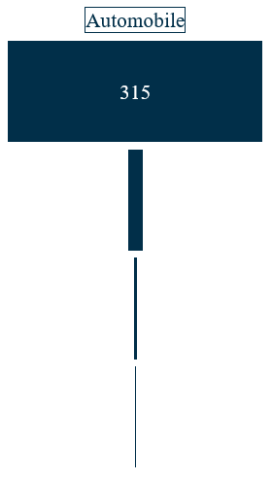
FUNNEL (FEMALE) (3)
20%
12%
6%
39%
49%
26%
48%
67%
20%

Slide 18
TRUST ON INFLUENCER ENDORSEMENT, PLATFORMS
AND
MEDIA PREFERENCE

Slide 19
TRUST ON INFLUENCER Endorsement (OVERALL)
Most of the respondents mentioned that influencers endorsing Tech and Gadgets category are more trustworthy.
84% of respondents, mention influencer endorsing tech and gadgets categories are trustworthy.

Slide 20
TRUST ON INFLUENCER Endorsement (MALE AND FEMALE)
Majority of the male respondents feel positive about influencer endorsing health and fitness category.
Majority of the female respondents feel positive about influencer endorsing tech and gadgets category.

Slide 21
ON WHICH SOCIAL MEDIA PLATFORM, THEY FOLLOW INFLUENCER? (OVERALL)
Majority of the respondents follow the influencer across social media like Instagram, TikTok YouTube, and Facebook.
47.14% of the respondents, follow the influencer on YouTube.

Slide 22
ON WHICH SOCIAL MEDIA PLATFORM, THEY FOLLOW INFLUENCER? (MALE AND FEMALE)
Majority of the male respondents follow the influencers across social media like Instagram, TikTok and YouTube.
Majority of the female respondents follow the influencers across social media like Instagram, TikTok and YouTube.

Slide 23
PREFERRED MEDIA TO GET INFORMATION ABOUT THE BRANDS (OVERALL)
Majority of the respondents prefer social media to get information about the brands.
85.08% of the respondents prefer social media to get information about the brands.

Slide 24
PREFERRED MEDIA TO GET INFORMATION ABOUT THE BRANDS (MALE AND FEMALE)
Majority of the male respondents prefer social media to get information about the brands.
Majority of the female respondents prefer social media to get information about the brands.

Slide 25
SOCIAL MEDIA
USAGE PATTERNS

Slide 26
WHICH SOCIAL MEDIA PLATFROMS THEY USE? (OVERALL)
Majority of the respondents use Instagram, YouTube & TikTok.
69% of the respondents use TikTok.

Slide 27
WHICH SOCIAL MEDIA PLATFROMS THEY USE? (MALE AND FEMALE)
Majority of the male respondents use Instagram.
Majority of the female respondents use Instagram.

Slide 28
HOW DO THEY SPEND MOST OF THEIR TIME ON SOCIAL MEDIA PLATFORMS? (overall) (1)
Majority of the respondents spend most of their time watching videos on Instagram, YouTube and TikTok.
87% of the respondents spend most of their time watching videos on YouTube.
94.71% of the respondents spend most of their time watching videos on TikTok.
25% of the respondents spend most of their time reading posts on Instagram.

Slide 29
HOW DO THEY SPEND MOST OF THEIR TIME ON SOCIAL MEDIA PLATFORMS? (overall) (2)
50% of the respondents spend most of their time reading posts on X (Previously Twitter)
66.06% of the respondents spend most of their time reading posts on Facebook.
35% of the respondents spend most of their time reading posts on LinkedIn.

Slide 30
HOW DO THEY SPEND MOST OF THEIR TIME ON SOCIAL MEDIA PLATFORMS? (male) (1)
Majority of the male respondents spend most of their time watching videos on Instagram, YouTube and TikTok.

Slide 31
HOW DO THEY SPEND MOST OF THEIR TIME ON SOCIAL MEDIA PLATFORMS? (male) (2)

Slide 32
HOW DO THEY SPEND MOST OF THEIR TIME ON SOCIAL MEDIA PLATFORMS? (Female) (1)
Majority of the female respondents spend most of their time watching videos on Instagram, TikTok and YouTube.

Slide 33
HOW DO THEY SPEND MOST OF THEIR TIME ON SOCIAL MEDIA PLATFORMS? (Female) (2)

Slide 34
WHAT TYPE OF CONTENT THEY WATCH? (OVERALL) (1)
Majority of the respondents watch reels on Instagram and web series on YouTube.
Among 87% of respondents who watch videos on YouTube, 36.57% watch web series.
Among 64.64% of respondents who watch videos on Instagram, 59.94% watch memes.

Slide 35
WHAT TYPE OF CONTENT THEY WATCH? (OVERALL) (2)
Among 22.99% of respondents who watch videos on Facebook, 84% watch reels.

Slide 36
WHAT TYPE OF CONTENT THEY WATCH? (MALE) (1)
Majority of the male respondents watch reels on Instagram and YouTube.

Slide 37
WHAT TYPE OF CONTENT THEY WATCH? (MALE) (2)

Slide 38
WHAT TYPE OF CONTENT THEY WATCH? (FEMALE) (1)
Majority of the female respondents watch reels on Instagram and web series YouTube.

Slide 39
WHAT TYPE OF CONTENT THEY WATCH? (FEMALE) (2)

Slide 40
HOW MUCH TIME THEY SPEND ON SOCIAL MEDIA DAILY? (OVERALL)
Majority of the respondents spend three to five hours on social media daily.
34.29% of the respondents spend three to five hours on social media daily

Slide 41
HOW MUCH TIME THEY SPEND ON SOCIAL MEDIA DAILY? (MALE AND FEMALE)
Majority of both male and female respondents spend three to five hours on social media daily.

Slide 42
AT WHAT TIME THEY USE SOCIAL MEDIA mostly? (OVERALL)
Majority of the respondents mostly use social media between 7 PM to 9 PM.
60% of the respondents use social media mostly between 7 p.m. to 9 p.m.

Slide 43
AT WHAT TIME THEY USE SOCIAL MEDIA mostly? (MALE AND FEMALE)
Majority of both male and female respondents mostly use social media between 7 p.m. to 9 p.m.

Slide 44
THANK YOU
Avant Garde Solutions Pvt. Ltd.
Sankhamul, Kathmandu, Nepal
+977 1 5242340 | 5912340
info@avantgarde.com.np
www.avantgarde.com.np

