Slide 1

Energy Drink Consumption & Preference Study
  30th July 2026

Slide 2
Research OBJECTIVES
1
To assess the penetration of energy drinks.
1
2
To assess Net Promotor Score (NPS).
3
To assess consumption pattern and purchase behavior.
4
To evaluate advertisement campaigns.

Slide 3
Methodology
Research Design
Quantitative data with the survey questionnaire
Data collection using digital data collection platform
Administered survey with experienced field enumerators
Computer Aided Personal Interview (CAPI) with the respondents
Sample Size: 253
Age Group: 18-64
Length of Interview (LOI): 15 mins.
Location: Kathmandu Valley
Field Work: 29th June to 14th July, 2026
Data Analysis
Descriptive statistics using Excel
Thematic analysis of open-ended data
Screener Criteria
Have consumed Energy Drink in the last three months.
Note: This study is internally conducted by Avant Garde Solutions in Kathmandu valley, Nepal.

Slide 4
FINDINGS

Slide 5
Demographics
Majority of the respondents are male, belonging to the age group 25-34 and are single.

Slide 6
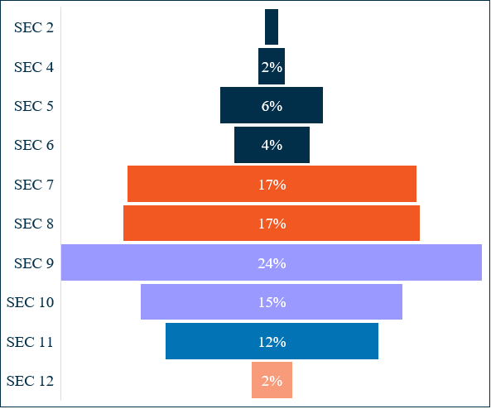
Socio-economic classification (SEC)
Majority of the respondents belong to Middle Class.
39% of the respondents belong to Middle Class

Slide 7
PENETRATION OF
ENERGY DRINKS

Slide 8
penetration OF ENERGY DRINKS
Overall Penetration
Total Sample 1000
Penetration In the Past One Month Based on Gender
Consumed in Last 12 Months | Consumed in Last 3 Months | Consumed in Last Month | Consumed in Last Week
35% | 25% | 20% | 14%
Male Total Sample 495 | Female Total Sample 494
30% | 10%
Penetration In the Past One Month Based on Age
Penetration In the Past One Month Based on Socio Economic Classification (SEC)
18-24 | 25-34 | 35-44 | 45-54 | 55-64
Total Sample 241 | Total Sample 392 | Total Sample 200 | Total Sample 112 | Total Sample 44
29% | 22% | 14% | 11% | 2%
Higher/Upper | Upper/Middle | Middle | Lower Middle
Total Sample 122 | Total Sample 375 | Total Sample 385 | Total Sample 98
23% | 17% | 20% | 26%

Slide 9
NET PROMOTOR SCORE (NPS)

Slide 10
NET PROMOTER SCORE (NPS)
How likely are you to recommend your brand of energy drink to your friends, family and colleagues?
Detractor =36.36%
Passive = 46.64%
Promoter = 17%
Net Promoter Score (NPS) = -19.36%

Slide 11
CONSUMPTION PATTERN
&
PURCHASE DECISION

Slide 12
CONSUMPTION FREQUENCY
How often do you consume Energy Drink?
Majority of respondents consume Energy Drink Once a week.

Slide 13
Number of Cans Consumed in a Day
How many cans do you drink in a day?
Majority of respondents consume one can in a day.

Slide 14
USUAL PURCHASE CHANNEL
Where do you usually purchase Energy Drink from?
Majority of respondents purchase Energy Drink from Local Convenience Store.

Slide 15
USUAL TIME OF CONSUMPTION
At what time of the day do you usually drink an energy drink?
Majority of respondents consume Energy Drink between 12 PM – 3 PM.

Slide 16
CONSUMPTION COMPANIONS
With whom do you usually drink an energy drink with?
Majority of respondents consume Energy Drink with Friends.

Slide 17
CONSUMPTION OCCASIONS
On what occasions do you usually drink an energy drink?
Majority of respondents consume Energy Drink while working.

Slide 18
BULK PURCHASE AND STORAGE FREQUENCY
Do you usually buy energy drinks in bulk and keep them stored at home for future consumption?
Majority of respondents don’t buy energy drinks in bulk and store them at home for future consumption.

Slide 19
PREFERRED CAN SIZE
Which can do you prefer for energy drink?
Majority of respondents prefer Short Can.

Slide 20
PREFERRED CAN COLOR
Which color of can do you prefer for energy drink?
Majority of respondents prefer Blue Color Can.

Slide 21
ADVERTISEMENT CAMPAIGN EVALUATION

Slide 22
CHANNELS OF ADVERTSIEMENT
Where have you seen any advertisement or promotional campaign for Energy Drink?
Majority of respondents reported seeing Energy Drink’s advertisement or promotional campaign on Hoarding boards at road/streets.

Slide 23
ADVERTSIEMENT RECALL ON SOCIAL MEDIA
On which social media platforms have you seen the advertisement of Energy Drink?
Majority of respondents recalled seeing Energy Drink’s advertisement or promotional campaign on Facebook.

Slide 24
THANK YOU
Avant Garde Solutions Pvt. Ltd.
Sankhamul, Kathmandu, Nepal
+977 1 5242340 | 5912340
info@avantgarde.com.np
www.avantgarde.com.np

